Slide 1
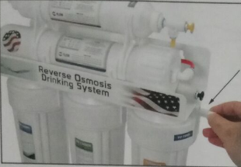
INSTALLATION STEP 1
QUICK CONNECT GUIDE
Before you install the system, you must learn how to properly connect/disconnect quick push-in fittings. The fitting CAN get damaged if inserted tubes are pulled out by force.
TO CONNECT / ATTACH
Push tubing / fitting straight in as far as it will go.
TO DISCONNECT / RELEASE
Push in collet by hand or the flat screw driver then pull out tubing / fitting to release.

Slide 2
INSTALLATION STEP 2
ELBOW FITTING CONNECTION
Screw the elbow fitting into the end of the
right filter housing (in) until tightened and
(the insert) is facing at a downward angle.
Screw the elbow fitting into the end of the
right filter housing (in) until tightened and
(the insert) is facing at a downward angle.
Screw the elbow fitting into the end of the
right filter housing (in) until tightened and
(the insert) is facing at a downward angle.
Screw the elbow fitting into the end of the
right filter housing (in) until tightened and
(the insert) is facing at a downward angle.
Screw the elbow fitting into the end of the
right filter housing (in) until tightened and
(the insert) is facing at a downward angle.
Screw the elbow fitting into the end of the
right filter housing (in) until tightened and
(the insert) is facing at a downward angle.
Screw the elbow fitting into the end of the
right filter housing (in) until tightened and
(the insert) is facing at a downward angle.

Slide 3
INSTALLATION STEP 3
FEED WATER ADAPTER
CAUTION !
Must use COLD water line for the RO system. HOT water will severely damage the system.
1.) Find the cold water (angle) shut off valve underneath the sink and turn it off.
2.) On single-handle kitchen faucets, the hot water may have to be turned off to prevent any hot water cross over.
3.) Open the cold water faucet to release the pressure.
4.) If the water continues to come out of faucet with angled valve turned off, the house main water must be turned off.
5.) Remove the cold water supply hose of the faucet from the valve.
6.) Install the adapter and the incoming feed water tube (red color) as shown below, make sure the O-ring is inserted in the proper position.
1/2” 3/8”

Slide 4
INSTALLATION STEP 4
DRAIN LINE ADAPTER
There are three configurations to install the drain line adapter. It depends upon if there is the garbage disposal with/without dishwasher under the sink.
A: Garbage disposal with Dishwasher
1.) shutting off the power supply of the disposal or the circuit breaker before starting work.
2.) ? Remove dishwasher drair, hose
from d/sposal by unscrewing hose
clamp, or expanding spring damp with
P*?ers. Move clamp away from disposal nipple, then twist
hose back and forth while pulling away from disposal to
separate. (See Rg. 1)

Slide 5
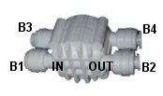
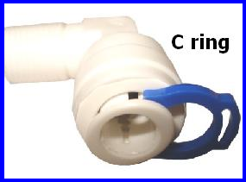
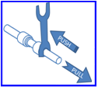

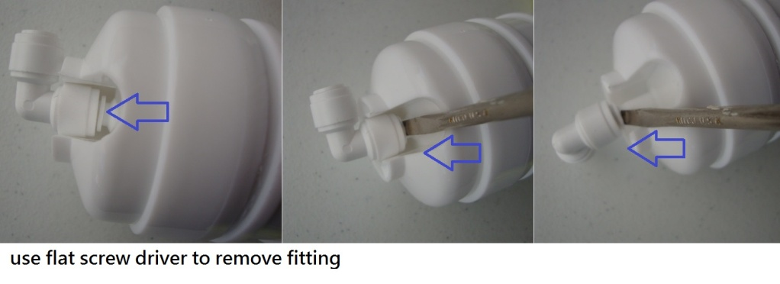
Whole RO System Quick Connectors Diagram
Please go to www.purewaterclub.com to see/download the colored version
C3
Post filter 2
C4
Position | Parts number | Connection
A1 | PT-4040Q | incoming water source in
A2 | PT-4040Q | 1th stage out
A3 | PT-4040Q | 2nd stage in
A4 | PT-4040Q | 2nd stage out
A5 | PT-4040Q | 3rd stage in
A6 | PT-4040Q | 3rd stage out
B1 | PT-ASOVQ | to 3rd stage out
B2 | PT-ASOVQ | to RO membrane
B3 | PT-ASOVQ | to check valve
B4 | PT-ASOVQ | to 5th stage
B5 | PT-4040Q | RO membrane in
B6 | PT-CV | Check valve to ASOVQ
B7 | PT-1144Q | to Flow Restrictor
B8 | PT-WASH | Flow Restrictor In (waste water)
B9 | PT-WASH | Flow Restrictor out, to drain
C1 | PT-4040Q | 5th stage in
C2 | PT-4040Q | 5th stage out
C3 | PT-4040Q | 6th stage in
C4 | PT-4040Q | 6th stage out, pure water output
C1
C2
Post filter1
B7
B8
B9
B5
B6
RO filter
B3
B4
B1
B2
A6
A5
A4
A3
A2
A1
Pre-filter3
Pre-filter2
Pre-filter1
Before you connect this RO, you must learn how to properly connect/disconnect quick push-in fittings. The fitting CAN get damaged if inserted tubes are pulled out by force.
If the fitting comes with a C ring on it, remove it first.
TO CONNECT
1
Insert tube all the way into the socket (push it in)
2
Try to pull the tubes to check for security.
TO DISCONNECT
Optional: You may find a collet release tool (fork) to be useful.
To disconnect, all you need is to push on the collet, then pull out the tube.
If using a fork (release tool), push it against the collet. Then pull out the tube.
Notes:
P3

Slide 6
express WATER
REVERSE OSMOSIS SYSTEM INSTALLATION MANUAL

Slide 7
INTRODUCTION You have purchased the finest residential Reverse Osmosis Drinking Water System available for your home. When property maintained, this system will provide you with years of great tasting, pure drinking water and trouble-free service. Please read the enclosed section regarding the proper care and maintenance of your new Water System, and experience the taste of exceptional purity. Please make sure to thoroughly read the installation manual and warranty information before any attempt to install this unit in your home.
Also, please make sure to inspect the package for any missing or shipping damages.

Slide 8
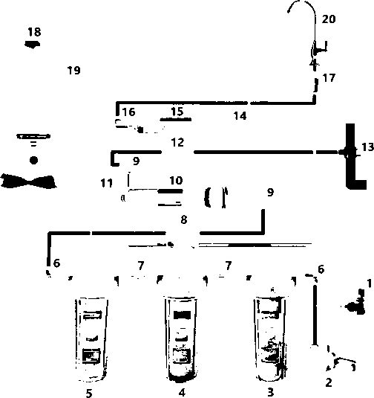


Feed Water Adapter Leak Detector Sediment Water Filter GAC Carbon Filter Carbon Block Filter Male Elbow 1/4“ Nipple Automatic Shut-Off Valve Male Elbow 1/8〃 RO Membrane Housing Check Valve Drain Flow Restrictor Drain Saddle Stem Tee Inline Granular Carbon Post Filter Stem Elbow Quick-Connect Faucet Connector Tank Valve Tank Faucet
ITEMIZATION OF COMPONENTS
y
System Filters
_
l\

Slide 9
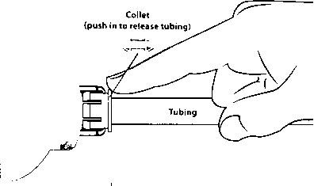
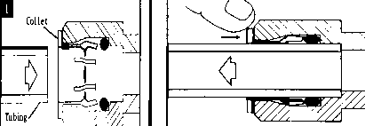
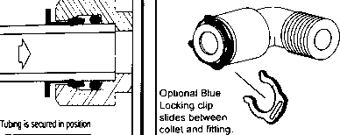
Pushing strap in as farasrtwill go. Push in collet to release tubing. ■ — TO INSERT LOCKING CLIP 0 r
CAUTION: When cutting supplied tubes, predetermine the length by measuring the distance between the components to be connected.
QUICK CONNECT GUIDE
TO ATTACH TUBING TO RELEASE TUBING

Slide 10
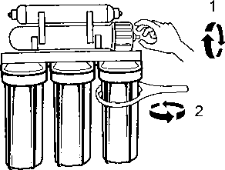
A TIGHTEN THE HOUSINGS
INSTALLATION STEP 1 TIGHTEN THE HOUSINGS
1. TIGHTEN BOTTOM HOUSINGS WITH PROVIDED WRENCH 2. TIGHTEN MEMBRANE HOUSING WITH YOUR HAND
DO NOT OVER TIGHTEN

Slide 11
1. Locate the cold water (angle) shut off valve (see picture above) underneath the sink and turn it off. Open the cold water faucet to release the pressure. On single-handle kitchen faucets, the hot water may have to be turned off to prevent any hot water cross over. If water continues to come out of faucet with angled valve turned off, the house main water must be turned off.
INSTALLATION STEP 3 FEED WATER ADAPTER
The water supply to the unit MUST be from the COLD WATER LINE. HOT WATER will severely damage your R.O. System.
CAUTION!

Slide 12
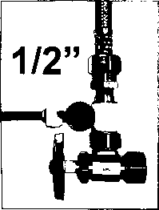
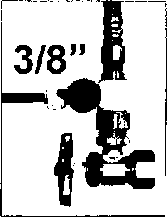
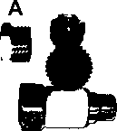
WARNING! WATER PRESSURE SHOULD NOT EXCEED 80 PSI
NOTE! DO NOT USE TEFLON TAPE (HAND TIGHTEN OR USE WRENCH) DO NOT OVER TIGHTEN
2. As shown above, this adapter connection can be used for both 3/8"or 1/2” feed line plumbing. Simply by switching the adapter nut like below (PART A) from one side of the adapter valve to the other.

Slide 13

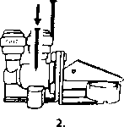
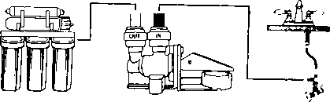
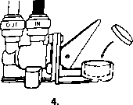
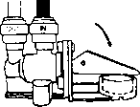
1. POSITION THE SYSTEM TO THE DESIRED PERMANENT LOCATION
INSTALLATION STEP 4 LEAK DETECTOR
POSITION THE LEAK DETECTOR IN THE SAME CABINET NEAR THE SYSTEM AND SCREW ITTOTHE FLOOR
CONNECT THE RED TUBE INTO THE FEED ADAPTER AND INTO THE INLET (IN) OF THE LEAK DETECTOR. CONNECT THE WHITE TUBE INTO THE OUTLET (OUT) OF THE LEAK DETECTOR AND INTO THE 1ST STAGE OF THE RO SYSTEM (INLET)
5. TURN THE SWITCH DOWN, AND THE LEAK DETECTOR IS READYTO BE USED
Note! Please avoid contact of any liquid to the compressed textile. Failure to do so will activate the textile and shut the incoming water.
TAKE OFF THE WRAP AND PLACE THE COMPRESSED TEXTILE
3.

Slide 14
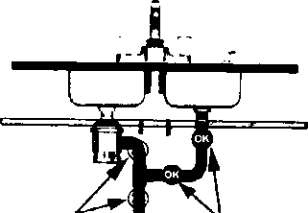
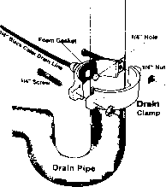
Position the drain saddle valve at selected location and mark for the opening. Drill V₄ -inch (6.3mm) hole at mark through one side of pipe. Remove backing from gasket and place adhesive side to the fitting half of drain clamp around hole. Position both halves of drain saddle on drain pipe so the opening aligns with drilled hole. Use a small drill bit to verify that drain clamp is properly aligned. Secure drain saddle clamp on valve with bolts and nuts provided. (Do not over tighten, and make sure there is equal space between saddle halves on each side.)
A Drain Saddle Valve is used to make a wastewater connection with the drain under the sink, and is designed to fit around a standard 1 1/2-inch OD drainpipe The drain saddle valve should always be installed before (above) the p-trap and on a vertical or horizontal drain. To avoid clogging the drain line with debris, do not install the drain saddle near a garbage disposal.
INSTALLATION STEP 5 DRAIN SADDLE VALVE
warning!!!! |  | mount Droin
never mount |  | Saddle Valvo at
hereiimiii |  | either location

Slide 15
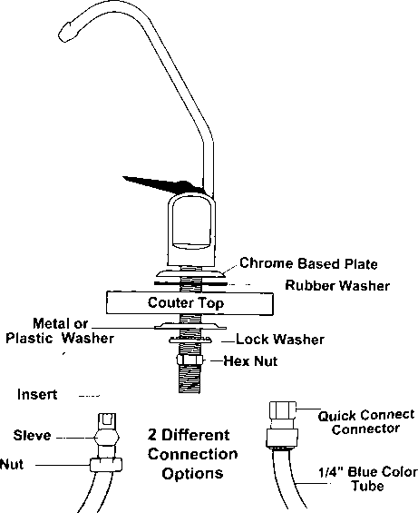
INSTALLATION STEP 6 RO FAUCET

Slide 16
Make sure the washer is big enough to cover the hole. If you drill a new hole on the countertop or sink, make sure that drilling the hole will not damage any pipe or wiring underneath the countertop or sink. Stainless Steel Sink Determine the desired location for your RO faucet on your sink surface. Place masking tape or duct tape on the determined location for the hole to be drilled. Use a variable speed drill set on slow speed and drill with a 1/8 inch (3mm) drill bit to make a center hole at the select location. Note! Use water or lubricant to keep the drill bit cool while drilling. Enlarge the hole using a V4 inch (6.4mm) drill bit. Use factory approved method or approved plumbing practice to drill hole in sink. Enlarge the hole to 1/2-inch diameter. Keep bit well lubricated and drill slowly. On top of the sink, insert the chrome base plate (Escutcheon plate), and the large rubber washer in that order over the threaded mounting tube at the base of the faucet. Under the sink, install the large metal (or plastic) washer and the star washer (or lock washer) over the threaded stem. Screw on the nut and tighten. Connect the freshwater line sleeve over the brass compression nut and the white plastic ferrule (do not use the brass ferrule) over blue tubing, then push to the end of the threaded stem. Screw on thecompression nut and tighten or use the quick connection adapter (PLEASE REFER TO PAGE 14)
Porcelain Sink To drill on a porcelain sink, a spring-loaded Relton style drill set is strongly recommended to prevent chipping. Avoid high speed drilling during the initial cutting of porcelain as this can cause chipping.
The RO Faucet may be installed on any flat surface. Check the underside of the location for interference. You may use the existing hole on the sink or drill a new hole.

Slide 17
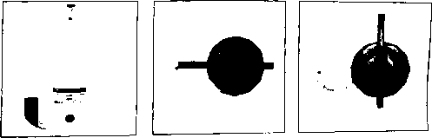
INSTALLATION STEP 7 RO TANK ASSEMBLY NOTE! Do not tamper with the air valve on low side of storage tank. It has been preset at 7-10 psi by the manufacturer. Open the box and remove the stand from the top of the tank. Wrap the thread 6-8 times with plumbers (Teflon) tape only. Connect the ball valve to the thread. Make sure it is tight but not overly tight. Place the storage tank in desire location. Since it is the pressure storage tank, it can stand up straight or lie down. Connect the (yellow) tubing from inline filter (5th stage) to the tank ball valve. (See 5-Stage RO system diagram page 6) Turn the tank ball valve on.
ON POSITION
OFF POSITION

Slide 18
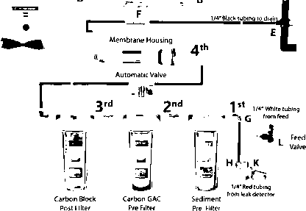
L to K. Connect the white tube into the feed adapter (point L) and to the inlet marked as "in" of the leak detector (point K) G to H. Connect the red colored tubing to first stage housing (point G) to the outlet marked as "out" of the leak detector (point H) A to B. Connect the yellow tubing from the storage-tank (point A) to the post carbon inline tee (point B). C to D. Connect the blue tubing from the faucet (point C) to the end of the post inline carbon marked as "to faucet" (point D). E to F. Connect the black colored tubing from the Drain Saddle Valve (point F) to the Flow Restrictor marked as "to drain" (point E).
SYSTEM CONNECTIONS
Long Reach Drinking Faucet
1/4* Blue tubing | to faucet I
Carbon Final Filter Cth
1 /4" Yellow tubing to tank

Slide 19
Turn on both the cold water supply and the under sink feed-water valve; but close the tank ball valve. If any leaks are noted, turn off valve and correct before proceeding. Open RO faucet for continuous flow (flow rate may vary). Check system for leaks; tighten when necessary. After 5 minutes, the water will start to drip out of the RO faucet. Let it drip for about 10 minutes and then flip the handle to the closed position. Turn on the tank ball valve. It will take several hours (2-3) for the storage tank to fill, depending on the incoming water pressure.
After the tank is full (you will hear the water stop), flush the system by placing the RO faucet in the open position until the water is completely discharged. WATER FLOW WILL CHANGE TO (DRIPPING) DEPENDING ON YOUR WATER PRESSURE.
Upon complete discharge of storage tank, turn handle to closed position on RO faucet and let the refilling process begin. This process could take 2-3 hours to complete. *******(REPEAT STEP 5 & 6 THREE T丨MES)*******
After the fourth tank is filled, you may drink the water. Check for leaks daily during the first week of use and periodically thereafter.
SYSTEM STARTUP
9. You may notice that the water may be milky colored dufjing tl^rst week. This is an indication of air bubbles in the water； it is normal and .
DO NOT DRINK THE WATER FROM THE FIRST TANK PRODUCED BY YOUR NEWLY PURCHASED SYSTEM.

Slide 20
THIS RO SYSTEM CONTAINS FILTERS THAT MUST BE REPLACED AT REGULAR INTERVALS TO MAINTAIN PROPER PERFORMANCE. USE ONLY FACTORY-APPROVED FILTERS. Cleaning Procedures The following system cleaning procedures are recommended every 12-18 months. Shut off the source water supply to the RO system. Open the RO faucet and depressurize the RO system and storage tank. Remove pre-filter cartridges, post-filter cartridges, and RO membrane. Discard or prepare for cleaning. If the RO membrane element is to be reused, disinfectant solution should be introduced into the permeate tube outlet sufficient to remove bio-film in this vulnerable area before reinserting the membrane into the housing. Wash the internal housing areas with warm soapy water using clean brush (do not scratch the surface of the housings). Be sure to clean O-ring grooves thoroughly. Remove the existing O-ring or prepare for cleaning. Rinse off all housing pieces with clean water to remove soap. Replace O-rings and lubricate. Pour the disinfectant solution into each of the clean housings and replace the housing on the RO system. Disconnect RO storage tank from the system.
Filter maintenance It is OK to store filters for several years. To keep the unopened filter sealed, place it into an airtight container, preventing it from absorbing air. This prolongs the shelf life of the carbon filter and avoids any possible odor from the air. Membrane maintenance The dry-packed membrane usually has a two-year shelf life. To prolong the shelf life, keep unopened dry membrane in the refrigerator. Once used, run the RO system every day for at least 10-15 minutes (about 1 gallon or 4 liters of drinking water). This helps maintain the membrane performance. If you will not be using the RO system for weeks, drain the storage tank completely. Fill the tank and drain it twice before using the RO system again.
SYSTEM MAINTENANCE This recommendation is intended for maximum efficiency of R〇 SYSTEM.

Slide 21


The first step is to make sure you have everything ready. You will need a bucket, a clean cloth, some dishwashing soap, the correct size replacement filters and a spare replacement membrane if necessary. Turn off the water supply to the Reverse Osmosis system and the tank valve and open the dispensing tap downstream to release the pressure. After releasing the pressure place the filter manifold in a bucket and unscrew the filter sumps using the supplied filter wrench to loosen the housings. Keep track of which filter came from which housing. Throw out the old filters and wash out the filter housings with dishwashing soap and rinse really well with cold water to remove soap. Make sure your hands are washed and un-wrap the new filters and place them inside the correct filter housing, make sure the o rings in the housings are wet. Tighten housings hand tight. If the membrane needs replacing (usually every 1 -2 years or more often if your water is hard or has high TDS) open the membrane housing by unscrewing the cap and pull out the membrane with a pair of pliers. Be sure to note which end is which. Wash out, rinse and refill housing with new membrane making sure you push it in firmly and close the housing by tightening the housing hand tight.
Wipe up any water from the the leak before going any further.
FILTER CHANGE

Slide 22
7. Top filter (Inline Carbon) please remove the locking clip from the two end With a use of your finger nail please push the collet in and while you are pulling the connection to disconnect the T and the elbow from the 2 end of the filter. Discard the old filter and connect the two connection to the both end of the new post carbon filter. 9, Now you can fully open the inlet tap and the tank valve and empty the tank and let the system refill with water, which takes about 2 to 4 hours. You can open the dispensing tap briefly to release any air trapped inside the system while it is filling. 8. After it has filled for 2 to 4 hours drain the entire system by opening the faucet till water flow reduces to a slow trickle then close the faucet and repeat the procedure 1 more time. Do not drain the system through a refrigerator water dispenser, the carbon fines from the new carbon filter will dog the internal fridge filter. If you have not replaced the membrane you are now finished. If the membrane was replaced you will need to fill and drain the entire system a total of 3-4 times or until there is no foul taste to the water.

Slide 23
PROBLEM | CAUSE | SOLUTIONS
Milky colored water Air buble in the water | V Air in system | 〇 Air in the system is a normal occurrence with initial startup of the RO system. This milky look will disappear during normal use within 1 to 2 weeks.
Noise from system | Air gap faucet Location of drain saddle Restriction in drain line | o Will disappear after system shut down o Relocate the drain to above water trap. o Blockage sometimes caused by debris from garbage disposal or dishwasher
Small amount of water from RO drinking faucet. | System just starting up Air pressure in the storage tank is low. | l o Normally it takes 2-3 hours to I fill tank. Low water pressure and/or temperature can reduce production rate. 〇 Add pressure to storage tank. The pressure should be 8-10 psi when the tank is empty
Slow production or no water from RO drinking faucet. | Low water pressure Crimps in tubing Clogged pre-filters Fouled membrane | o Add a booster pump, o Make sure tubing is straight. 〇 Replace pre-filters. 〇 Replace membrane.
Water taste or smell offensive | Post carbon is depleted. Fouled Membrane Sanitizer not flushed out | o Replace post carbon. 〇 Replace membrane, o Drain storage tank and refill it overnight.
No drain water | V Clogged flow restrictor | o Replace flow restrictor.
Leaks | Fittings are not tightened. Twisted O-ring Misalignment of hole in the drain saddle valve. | 〇 Tighten fittings as necessary, o Replace the O-ring. o Realign drain saddle valve.
TROUBLESHOOTING Note: Turn off the system before servicing or inspecting.

Slide 24
READ THIS FIRST Please pay attention to the following installation and safety recommendations: .Read the installation manual before installing this system. ' Install the system at a location with adequate drainage. This water system unit is for INDOOR use ONLY.To preserve the unit, avoid using extremely HOT/COLD water, and protect against sudden temperature changes. .Install the system under supervision of a professional, licensed installer or plumber. .Inspect all connections after the installation to make sure NO LEAKS occur. Wait and inspect the system AFTER the water is pressurized. MUST install the pressure regulator at the high water pressure area (over 80PSI). Strongly recommended: SHUT OFF the water supply when homeowner/user will not be using the water system for a long period of time. IMPORTANT Please contact your insurance carrier before installing the water system. The manufacturer WILL NOT cover ANY water damage under any circumstance. These are our recommendations to avoid any water damage. .Must install the PRESSURE REGULATOR/PRESSURE LIMITING VALVE and LEAK DETECTOR SHUTOFF DEVICE to avoid water damage. • Homeowner/User is obligated to properly maintain the water system unit periodically, which includes the following: Replace the O-ring seals on the filter canister, fitting and filter cartridges. Replace the fitting connectors with proper replacement parts. Replace the filter canisters with proper replacement parts Replace the filter cartridges with the correct size and length replacements. Replace the water seal tape on ALL connector fittings ALL O-RING SEALS, FITTINGS, FILTER CANISTERS, AND WATER SEAL TAPE WEAR OUT AFTER CERTAIN PERIOD OF TIME. THE LIFETIME OF THESE COMPONENTS ARE SUBJECT TO WATER QUALITY. THEREFORE, ADEQUATE MAINTENANCE IS NECESSARY AND MANDATORY
WARNING DO NOT INSTALL THE SYSTEM WHERE THE WATER IS MICROBIOLOGICALLY UNSAFE OR OF UNKNOWN QUALITY ADEQUATE DISINFECTION BEFORE OR AFTER THE SYSTEM
WARRANTY
• Please contact a professional, licensed installer or plumber who meets the above requirements.The Manufacturer's insurance carrier WILL NOT cover any loss. Please consult your own insurance carrier for terms and conditions.
PRODUCT WARRANTY For further details, please refer to supplier’s terms and conditions of sales.

Slide 25
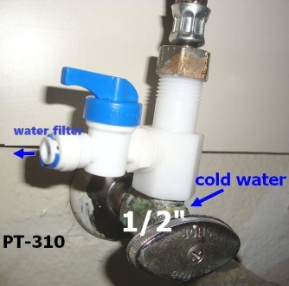
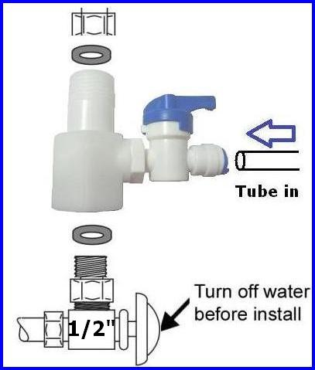
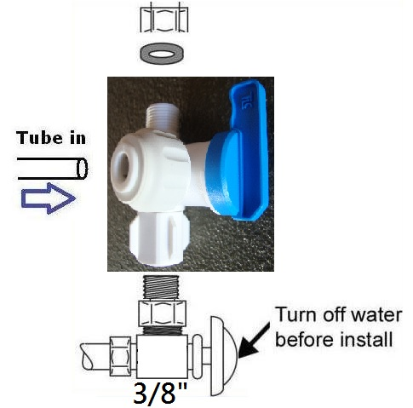
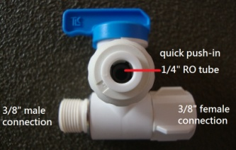
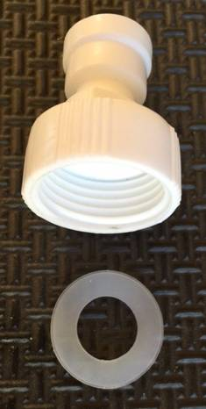
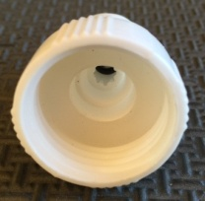
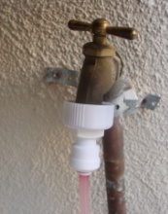
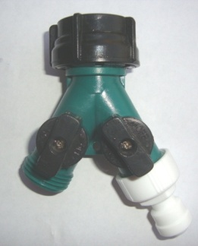
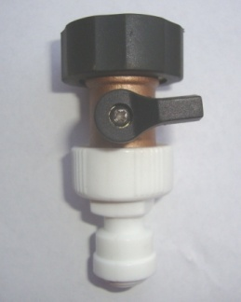
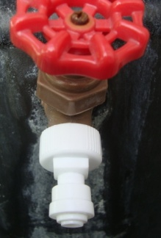
Installation Guide
Installation Step 1: Assembling Water Feeder
Simple plumbing knowledge and ability is required to install the system (or you may hire a plumber).
You may need a towel, bucket, 2 adjustable wrenches, Teflon tape, screwdriver, and drill.
UNDER-SINK (OPTIONS A, G)
1/2“ (or 3/8”) inlet 1/2“ (or 3/8”) outlet 1/4" RO tube with ball valve
Works for kitchen/bathroom under sink 1/2“ (or 3/8”) shut off valve
  PT-310
1) Find the shut-off valve under-sink (cold water only) turn off the water and remove the faucet supply hose from the valve.
2) Measure the inner diameter of the pipe (3/8” or 1/2”.)
3) Wrap some Teflon tape on the thread.
A
  PT-38BV
G
Install water feeder as picture, make sure the O-ring is inserted in the proper position. Use some Teflon tape on the thread.
GARDEN HOSE / LAUNDRY (OPTION B)
  PT-Q34A
B
garden brass hose bibb/spigot or laundry plastic split adapter
3/4" inlet 1/4" tube outlet
make sure to insert o-ring into proper position (see left)
can screw on the adapter by hand (no tools required)

Slide 26
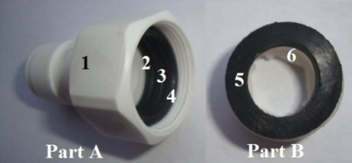
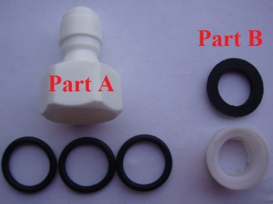
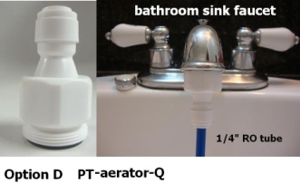
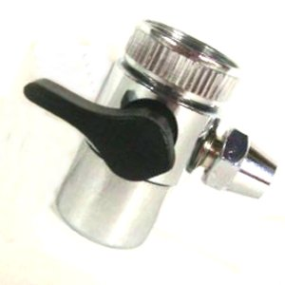
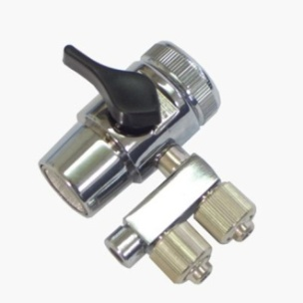
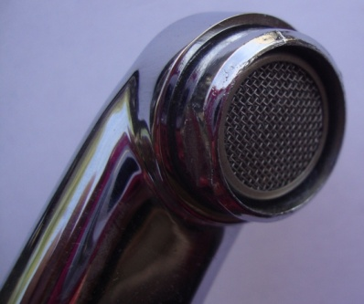
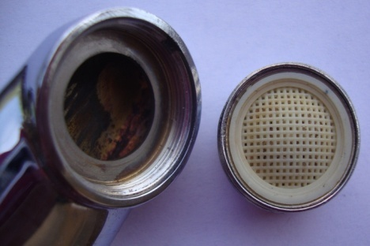
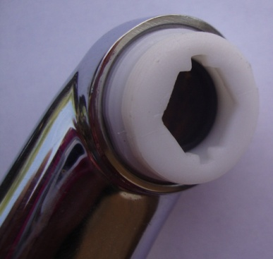
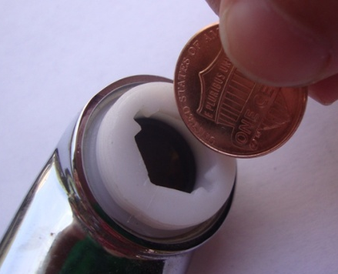
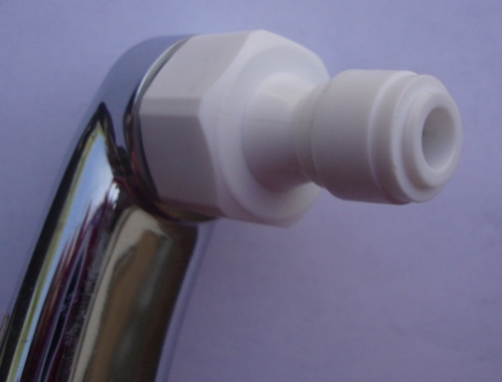
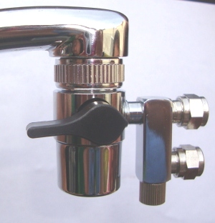
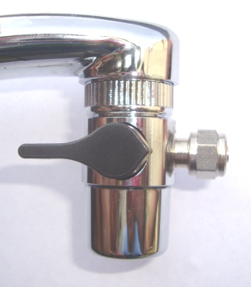
SINK FAUCET (OPTIONS D, E, F)
Kitchen/bathroom sink faucet adapter
  PT-aerator-Q
Aerator faucet connector
D
Assemble
faucet adapter with 1/4” quick connection
3 black o-rings for faucet adapter
white female/male converter
black o-ring for converter
  PT-2W2
  PT-3W2
E
F
Two way switch
Includes a converter
+ black o-ring (part B)
Three way switch
Includes a converter
+ black o-ring (part B)
For Options D, E, and F, please assemble as the following:
Bottom-up faucet view.
Remove the spray aerator adaptor from the faucet.
Twist in the converter (Part B.)
Use a coin as a wrench to tighten the converter
(clockwise). Avoid using an actual wrench
because it can bend/break the converter’s thread.
Twist in the sink adaptor.
1
2
3
4
5
Final product (Options D, E, or F):
D
E
F

Slide 27
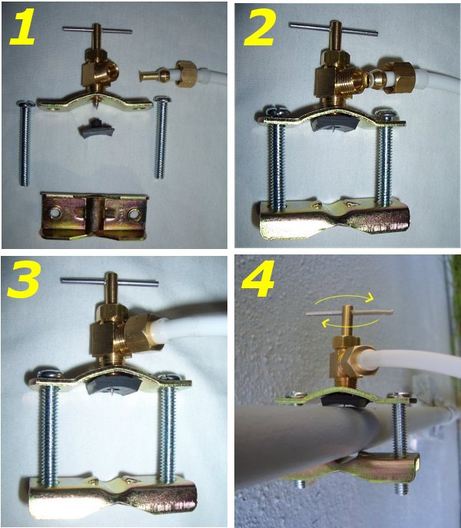
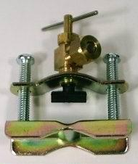
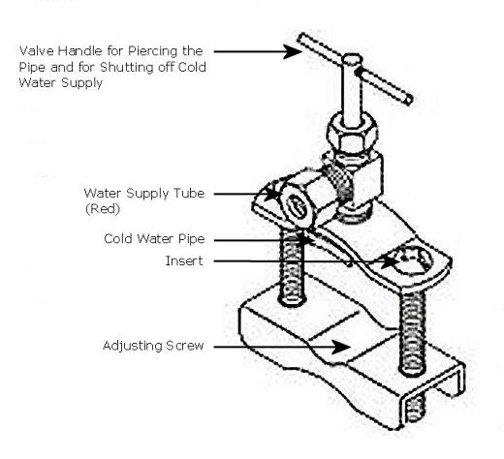
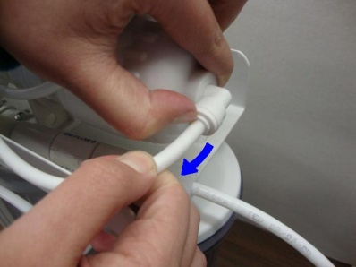
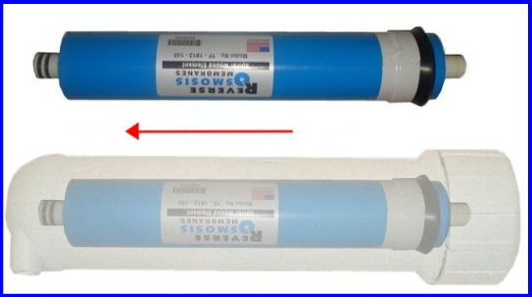
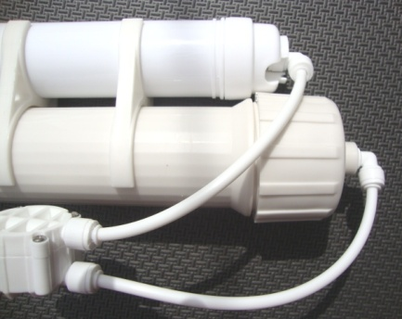

NEEDLE VALVE (OPTION C)
  PT-NED
C
for PVC pipe only
Please assemble as pictured:
Installation Step 2: Inserting the RO Membrane
If membrane housing already has the fitting and tube connected, remove tube from RO housing
Take out the membrane from the clear plastic wrapping, then insert membrane into housing (the end with 2 black rings go in first)
O-ring
The membrane must be inserted all the way to the end. You must be able to twist on the cap completely.
Twist on the cap of the housing, then
re-connect the tube from auto shut off valve.
Important: The membrane housing should come with a white O-ring.
The sticky grease on it is Vaseline, which will prevent leaking.
If the ring is missing, water will leak from the housing.
Please contact us if you’re missing the O-ring.

Slide 28









Installation Step 3: Flow Restrictor (Drain)
Important:
The water that comes out from the restrictor is WASTE water, please do not consume. (You may, however, use it to water lawns, wash clothes/cars, etc.)
The other end of the flow restrictor MUST be open and free to flow. It CANNOT be blocked off OR connected back to the RO system as an incoming water source!
Insert the red tube into the flow restrictor. The other end is where waste water comes out.
The ratio from pure water to waste water is 1:3.
The Drain Saddle Valve Installation
Remember, you MUST match the hose opening with the drilled hole. Screw in the saddle valve together tightly.
Drain Pipe
¼” Nut
Drain Clamp Front Plate
Drill a 0.3-0.4 mm hole on the drain pipe
DO NOT drill hole on the bottom of the pipe.
DO NOT lead waste water back to water supply.
¼” Screw
Drain Clamp Back Plate
Red Drain Tube
The Pressure Water Tank Installation (optional)
The pressure water tank contains a rubber bladder inside, so the water may taste strange. If using the tank for the first time, please fill it fully with water then drain it out for at least 3 times to clean it out.
Opening on the top and valve
Screw in the valve
Valve open position
Valve close position
Notes:
p2

Slide 29





Long Reach Faucet Installation (optional)
Quick installer kit (PT-LQfaucet) available on our store (optional)
Most sinks have an extra hole for the mounting of additional faucets, sprayers or soap dispensers. If your sink does not already have an additional hole, you may need to drill 1 " hole on the countertop. Carefully mark the faucet location, making sure it is far away enough from the regular water faucet so that they don't interfere with each other. Look to see if you can tighten the lock nut from below, before you drill a hole. Once the hole is prepared, assemble all parts together.
The Floating Valve Installation (optional)
Floating valve can be adjusted by using a screwdriver to any angle you want. Drill a hole on the tank where you want the water line to be reached.
Installation Step 4: Flushing the RO System
Check to see if all the tubes and fittings are secured properly.
Turn on the water source and check for any leaking. If a fitting is leaking, please go back and reconnect the tube to the fitting. If you cannot stop the leaking, please contact us.
Let about 5-10 gallons of water flush through the system. This way, the pure water will be safe to use.
DO NOT consume the pure water produced in the initial flushing of the system.
Notes:
P4

Slide 30
Q&A and Troubleshooting
Q: Why is the PPM of my pure water around same as the tap water? The water flow seems fairly fast.
A: Make sure you have inserted the RO membrane into the RO housing properly.
Q: Why does the system produce less pure water than it produces waste water?
A: This is normal; the ratio for the pure and waste water should be 1:3.
Q: Why does the system produce more pure water than it produces waste water?
A: This is not normal; you may have connected the tubes incorrectly. Please refer back to our diagram on the first page.
Q: Why does my pure water taste weird, sulfuric, fishy, etc, and the water appears yellow/blackish?
A: DI water is no good for human drinking; carbon filter must be added to improve taste. Be sure that you have completely flushed the whole RO system with at least 10-15 gallons of water.
Q: Why isn’t my DI water reaching 0 PPM?
A: We guarantee that you will reach 0 PPM water with your DI filter. When your water source has less than 300 PPM, try to reduce the water pressure; a high water pressure will make the water flow out too quickly without allowing enough time for it to filter through.
Q: My RO system is making noise from its auto shut-off valve.
A: Please check your water pressure; if you use a booster pump, set it to 60-65 PSI.
Q: My drain water never shuts off automatically.
A: An auto shut-off valve only works with a float valve, or any CLOSED container such as a pressure tank, an ice maker, etc. If the container is not closed, then you have to turn off the incoming water manually.
Q: Can I blow air through the check valve?
A: No. The check valve is a non-return valve that only allows water to flow in one direction; it cannot be blown through so easily.
Q: I installed a float valve on the portable system. It was able to stop pure water, but why is the waste water still coming out?
A: An auto shut-off valve must also be installed for water to be automatically shut-off.
Q: My DI output no longer provides me 0 PPM but only higher; do I need to change a new DI?
A: One DI can filtrate about 300 gallons of pure water.
All DI filters (inline or cartridge type) suffer from channeling effect. DI resin would shrink in size when they have been used. Then, some water may pass through the resin without been filtered; the water will find the easiest way to go through the filter, and that is the channeling effect.
The TDS reading will start off from 0 PPM, and will increase over time as the DI filter is used. A high PPM indicates that the DI filter has to be replaced. When PPM rises, partial or all resin should be replaced to achieve better water quality, especially if your PPM is over 300. Typically, you can just throw out your current DI filter and replace it with a new one, or you can use refill-able DI cartridge to add new resin to keep water always at 0 PPM.
The longer the water stays inside the DI filter, the better the filtration. So adding another stage DI is a very good method.
Q: I have a leaking problem.
A: First at all, check the leaking from the thread (the screw on the housing end) or from the tube plug-in end.
If leaking is from the thread, please detach the fitting and wrap more Teflon tape on it, then re-screw it back into the housing.
If leaking is from tube-plug-in side, cut off a small piece of tube from the end, because it could be slanted, twisted, or deformed. Please disconnect the tube and re-push the tube all the way into the socket. If the tube is not long enough, replacing a new tube can usually solve the leaking problem.
If you have pre-filter housing leaking problem, please try twisting open the leaking stage housing. Take out the o-ring and check if the ring is still in good shape. Or try to find if there is any manufactory defects on the groove of the housing, that would cause it to seal improperly. If everything looks good, add some Vaseline on the o-ring and groove, then re-screw on the housing. This will usually resolve the leaking problem.
Notes:
P6

Slide 31









WARNINGS, TIPS, AND USEFUL INFORMATION
For sanitary reasons, you MUST insert membrane by yourself.
Prepare plumbing tools such as wrenches, screwdriver, Teflon tape, protecting eye-glasses, etc.
Only connect the RO with cold water and a clean water source, NO seawater.
Recommended water source TDS reading is not to exceed 1000 PPM.
The RO system should never be placed under direct sunlight or under freezing temperatures if it is placed outside.
Maximum temperature: 113ºF. Minimum temperature: 33ºF.
35 PSI minimum is requited for the RO to operate, at 65 PSI 25°C is best.
If the pressure of the incoming tap water is too low (less than 35 PSI), a booster pump is required.
If water pressure exceeds 85 PSI, a pressure regulator (PT-regulator) must be installed.
The installer is responsible for any leaks resulting from installation of tube or related fittings.
You must check over the entire unit completely while under proper water pressure to ensure that the unit is not leaking and is functioning properly.
Please flush the whole RO system for at least 10-15 gallons, or drain out the water tank at least 3 times for first-time usage.
The RO comes with an auto shut-off valve. An auto shut-off valve only works with a float valve, or any CLOSED container such as a pressure tank, an ice maker, etc. If the container is not closed, then you have to turn off the incoming water manually.
All RO systems will create waste water. Most RO systems are designed for 1:(3.5 - 4.5) as standard. We used a 450 Flow Restrictor; the ratio from pure to waste water is 1:3.
Replace all pre-filters and post-filters per 6-12 months, depending on the water source's quality.
Replace membranes per 1-2 years.
Change the DI filter per 500 gallons.
OTHER PRODUCTS
Want to get creative and customize your RO system with more efficiency?
Here we have more products, some handy/useful parts and tools, that will allow you to make things easier for you as you install your RO system. Please note that all products in this section are sold separately.
Refillable DI Resin/Cartridge
(OT-RES-HOUDI)
Pressure regulator
(PT-regulator)
(PT-LQfaucet)
Pressure Gauge (PT-PSI-150)
Float-Valve Bracket Kit (PT-FVBS)
TDS Meter (PT-TDS-1)
We also offer many other connectors and adapters to suit your personal RO needs.
Please email us at rosales@purewaterclub.com!

