Slide 1
REVERSE OSMOSIS SYSTEM
INSTALLATION MANUAL

Slide 2
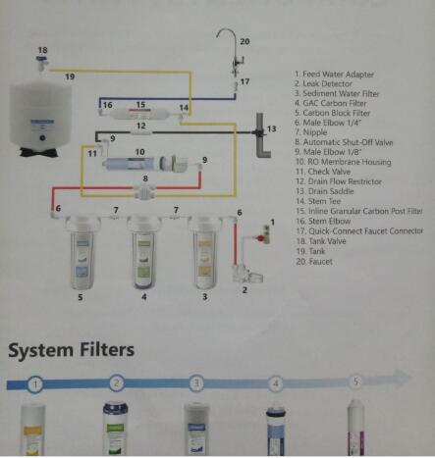
RO SYSTEM DIAGRAM
FILTERS / CONNECTERS / PARTS

Slide 3
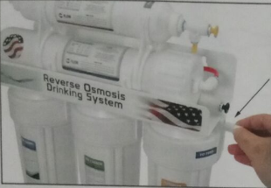
INSTALLATION STEP 1
QUICK CONNECT GUIDE
Before you install the system, you must learn how to properly connect/disconnect quick push-in fittings. The fitting CAN get damaged if inserted tubes are pulled out by force.
TO CONNECT / ATTACH
Push tube / fitting straight in as far as it will go.
TO DISCONNECT / RELEASE
Push in collet by hand or the flat screwdriver, then pull tube / fitting / stopper out to release.

Slide 4
INSTALLATION STEP 2
INITIAL FITTING CONNECTION
Screw the elbow fitting into the end of the right filter housing (in) until tightened and (the insert) is facing at a downward angle.
Fully insert the red tubing into the fitting. Apply force while pushing tube into fitting to ensure the quick connect has locked.
Screw the elbow fitting into the end of the left filter housing (out) until tightened and (the insert) is facing at a 11 O’clock degree.
Fully insert the red tubing into the fitting. Apply force while pushing tube into fitting to ensure the quick connect has locked.
FEED-Fully insert the red tubing into the fitting. Apply force while pushing tube into fitting to ensure the quick connect.
DRAIN-Fully insert the red tubing into the fitting. Apply force while pushing tube into fitting to ensure the quick connect has.
DRAIN-Fully insert the red tubing into the fitting. Apply force while pushing tube into fitting to ensure the quick connect has..

Slide 5
RO-DRAIN-Fully insert the red tubing into the fitting. Apply force while pushing tube into fitting to ensure the quick connect
RO-DRAIN-Fully insert the red tubing into the fitting. Apply force while pushing tube into fitting to ensure the quick connect
RO-DRAIN-Fully insert the red tubing into the fitting. Apply force while pushing tube into fitting to ensure the quick connect
Tank-DRAIN-Fully insert the red tubing into the fitting. Apply force while pushing tube into fitting to ensure the quick connect.
Tank-DRAIN-Fully insert the red tubing into the fitting. Apply force while pushing tube into fitting to ensure the quick connect..
FAUCET. -DRAIN-Fully insert the red tubing into the fitting. Apply force while pushing tube into fitting to ensure the qui
FAUCET. -DRAIN-Fully insert the red tubing into the fitting. Apply force while pushing tube into fitting to ensure the qui.

Slide 6
INSTALLATION STEP 3
FEED WATER ADAPTER
CAUTION !
Must use COLD water line for the system. HOT water will severely damage the system.
1.) Find the cold water (angle) shut off valve underneath the sink and turn it off.
2.) On single-handle kitchen faucets, the hot water may have to be turned off to prevent any hot water cross over.
3.) Open the cold water faucet to release the pressure.
4.) If the water continues to come out of faucet with angled valve turned off, the house main water must be turned off.
5.) Remove the cold water supply hose of the faucet from the valve.
6.) Install the adapter and the incoming feed water tube (red color) as shown below, make sure the O-ring is inserted in the proper position.
1/2”
3/8”
ON Position
OFF Position

Slide 7
INSTALLATION STEP 4
DRAIN LINE ADAPTER
There are three configurations to install the drain line adapter. It depends upon if there is the garbage disposal with/without dishwasher under the sink.
NOTE: Use tautness of dishwasher hose to keep tail of adapter slightly above horizontal. It is important for proper drainage and a clog free installation, if dishwasher hose material cannot be easily shortened or it is undesirable to do so, attach uncut end of hose to adapter, then tie up remaining slack with suitable material.
A: Garbage disposal with Dishwasher
1.) Shut off the power supply of the disposal or the circuit breaker before starting work.
2.) Remove dishwasher drain hose from disposal by unscrewing hose clamp, or expanding spring clamp with
pliers. Move clamp away from disposal nipple, then twist
hose back and forth while pulling away from disposal.
3.) Scrape the inside of exposed disposal nipple with a screwdriver to remove any buildup caused by dishwasher.
4.) Mount provided hose coupler one inch over disposal nipple. Then slip both provided new stainless steel hose clamps loosely over hose coupler.
5.) Slide the three-way adapter into remaining one inch of hose coupler until firmly seated against disposal nipple. Orient the ‘smaller branch" in a vertical position to connect RO drain tube. Tighten both hose clamps securely over hose coupler so that the three-way adapter is solidly mounted on disposal.
6.) Lift tail of adapter slightly higher than horizontal, and position semi-taut hose behind it. Take a measurement on the hose against the three-way adapter. Cut off excess hose squarely with a sharp Knife, then reuse original hose clamp and tighten securely.
7.) Insert the rubber plug with elbow quick fitting into the smaller branch of the three-way adapter. Then insert the RO drain tube (gray color) into the elbow quick fitting.

Slide 8
B: Garbage disposal without Dishwasher
1.) Shut off the power supply of the disposal or the circuit breaker before starting work.
2.) Knock out the plug inside the disposal nipple by using a hammer and flat screwdriver. Tap away all edges of the knock out plug until only a round hole remains. Remove all pieces of plug left inside disposal. Run fingers carefully to search for any hidden fragments.
3.) Mount provided hose coupler one inch over disposal nipple. Then slip both provided new stainless steel hose clamps loosely over hose coupler.
4.) Slide the bigger end of the two-way adapter into remaining one inch of hose coupler until firmly seated against disposal nipple. Tighten both hose clamps securely over hose coupler so that the two-way adapter is solidly mounted on disposal.
5.) Lift tail of adapter slightly higher than horizontal, and position semi-taut hose behind it. Take a measurement on the hose against the two-way adapter. Cut off excess hose squarely with a sharp Knife, then reuse original hose clamp and tighten securely.
6.) Insert the rubber plug with elbow quick fitting into the smaller end of the two-way adapter. Then insert the RO drain tube (gray color) into the elbow quick fitting.
C: Drill hole on drainpipe (no garbage disposal)
1.) The rubber drain plug is used to make a wastewater connection with the drainpipe under the sink. The rubber drain plug should always be installed before (above) the p-trap and on a vertical or horizontal drain. To avoid clogging the drain line with debris, do not install the drain saddle near a garbage disposal.
2.) Position the rubber drain plug at selected location and mark for the opening. Drill ½-inch (12.7mm) hole at mark through one side of pipe.
3.) Insert the rubber plug with elbow quick fitting into the hole of the drainpipe. Then insert the RO drain tube (gray color) into the elbow quick fitting.

Slide 9
INSTALLATION STEP 5
PURE WATER FAUCET
Most sinks have an extra hole for the mounting of additional faucets, sprayers or soap dispensers. If your sink does not already have an additional hole, you may need to drill 1 " hole on the countertop. Carefully mark the faucet location, making sure it is far away enough from the regular water faucet so that they don't interfere with each other. Look to see if you can tighten the lock nut from below, before you drill a hole. Once the hole is prepared, assemble all parts together.
The RO Faucet may be installed on any flat surface. Check the underside of the location for interference. You may use the existing hole on the sink or drill a new hole.
Make sure the washer is big enough to cover the hole. If you drill a new hole on the countertop or sink, make sure that drilling the hole will not damage any pipe or wiring underneath the countertop or sink.
With Bracket

Slide 10
Stainless Steel Sink
1. Determine the desired location for your RO faucet on your sink surface.
2. Place masking tape or duct tape on the determined location for the hole to be drilled.
3. Use a variable speed drill set on slow speed and drill with a 1/8 inch (3mm) drill bit to make a center hole at the select location.
Note!
Use water or lubricant to keep the drill bit cool while drilling.
4. Enlarge the hole using a V4 inch (6.4mm) drill bit. Use factory approved method or approved plumbing practice to drill hole in sink.
5. Enlarge the hole to 1/2-inch diameter. Keep bit well lubricated and drill slowly.
6. On top of the sink, insert the chrome base plate (Escutcheon plate), and the large rubber washer in that order over the threaded mounting tube at the base of the faucet.
7. Under the sink, install the large metal (or plastic) washer and the star washer (or lock washer) over the threaded stem. Screw on the nut and tighten.
8. Connect the freshwater line sleeve over the brass compression nut and the white plastic ferrule (do not use the brass ferrule) over blue tubing, then push to the end of the threaded stem. Screw on thecompression nut and tighten or use the quick connection adapter (PLEASE REFER TO PAGE 14)
Porcelain Sink
To drill on a porcelain sink, a spring-loaded Relton style drill set is strongly recommended to prevent chipping. Avoid high speed drilling during the initial cutting of porcelain as this can cause chipping.

Slide 11
INSTALLATION STEP 6
WATER STORAGE TANK
NOTE :
Do not tamper with the air valve on low side of storage tank. It has been preset at 7-10 psi by the manufacturer.
1.) Open the box and remove the stand from the top of the tank.
2.) Wrap the thread 6-8 times with plumbers (Teflon) tape only.
3.) Connect the ball valve to the thread. Make sure it is tight but not overly tight.
4.) Place the storage tank in desire location. Since it is the pressure storage tank, it can stand up straight or lie down.
5.) Connect the (yellow) tubing from inline filter (5th stage) to the tank ball valve. (See 5-Stage RO system diagram page 6)
6.) Turn the tank ball valve on.
Connect Valve
ON Position
OFF Position

Slide 12
STARTUP STEP 1
FLUSHING 3 PRE-FILTERS (10 min.)
It is important for initial flushing three pre-filters to maintain the RO membrane performance more safe and efficient.
Front-RO-In
Back-Drain-Out
OFF Position
ON Position
1.) Turn off the Front-RO-In valve (red color tube) , and turn on the Back-Drain-Out valve (gray color tube) to make flushing water flowing from pre-filters to drainpipe directly, as shown above.
2.) Turn on both the cold water supply and the under sink feed water valve to start initial flushing pre-filters about 10 minutes.
3.) If any leaks are noted, turn off the valve. Check to see if all the tubes ,housing and fittings are secured properly, correct and tighten them.
4.) Turn off the feed water valve to stop initial flushing pre-filters.
5.) Turn on the Front-RO-In valve (red color tube) , and turn off the Back-Drain-Out valve (gray color tube) to make flushing water flowing from pre-filters to RO membrane housing, as shown below.
Front-RO-In
Back-Drain-Out
ON Position
OFF Position

Slide 13
STARTUP STEP 2
FLUSHING RO, TANK, POST-FILTER (6 hr.)
DO NOT drink the water produced in the initial flushing of the system.
1.) Turn off the tank ball valve and open the pure water faucet for continuous flow (flow rate may vary). After few minutes, the water will start to drip out of the pure water faucet.
2.) If any leaks are noted, turn off the valve. Check to see if all the tubes ,housing and fittings are secured properly, correct and tighten them.
Filling The Water Storage Tank
3.) Then turn on the tank ball valve and close the pure water faucet to start flushing the RO membrane and filling the tank for two hours.
Discharging The Water Storage Tank
4.) After two hours, open the pure water faucet to start flushing the water storage tank and post-filter until the water flow changing to dripping (the tank is completely discharged).
5.) REPEAT Filling (Step 3) and Discharging (Step 4) the water storage tank TWO MORE TIMES.
6.) Close the pure water faucet to finish the initial flushing and start filling the fourth last tank, then you may drink the pure water.
7.) Check for leaks daily during the first week of use and periodically thereafter. If you cannot stop the leaking, please contact us.
8.) You may notice that the water may be milky colored during the first week. This is an indication of air bubbles in the water and it is normal and safe to drink.

Slide 14
Troubleshooting & FAQ
Q: Why does the system produce small amount of water or no water from pure water faucet?
A: There are some different situation:
If the RO system just start up, normally it may takes 2-3 hours to fill the tank.
Please check if the air pressure in the storage tank is too low. If so, please add pressure to storage tank. The pressure should be 8-10 psi when the tank is empty.
Please check if the sanitizer of the tank is flushed out. If not, please drain tank and refill it overnight.
Please check if there is any crimps in tubing. If so, please make sure all the tubing are straight.
Please check if any pre-filter is clogged. If so, please replace the pre-filter.
Please check if the RO membrane is fouled. If so, please replace the RO membrane.
Q: Why does my pure water taste or smell offensive?
A: There are some different situation:
Please check if the post-filter is depleted. If so, please replace the post-filter.
Please check if the RO membrane is fouled. If so, please replace the RO membrane.
Please check if there is any crimps in tubing. If so, please make sure all the tubing are straight.
Q: Why does the system produce less pure water than it produces waste water?
A: This is normal; the ratio for the pure and waste water should be 1:3.
Q: Why does the system produce milky colored water and/or air bubble in the pure water?
A: This is normal; air in the system is a normal occurrence with initial startup of the RO system. This milky look will disappear during normal use within 1 to 2 weeks.
Q: Why does the system produce no waste water?
A: Please check if the flow restrictor is clogged. If so, please replace the flow restrictor.
Q: My RO system is making noise from its auto shut-off valve.
A: Please check your water pressure; if you use a booster pump, set it to 60-65 PSI.
Q: My RO system is making noise from its restriction in drain line.
A: It may be blocked sometimes caused by debris from garbage disposal or dishwasher.
Q: I have a leaking problem.
A: First at all, check the leaking from the thread (the screw on the housing end) or the tube plug-in end.
If leaking is from the thread, please detach the fitting and wrap more Teflon tape on it, then re-screw it back into the housing.
If leaking is from tube-plug-in side, cut off a small piece of tube from the end, because it could be slanted, twisted, or deformed. Please disconnect the tube and re-push the tube all the way into the socket. If the tube is not long enough, replacing a new tube can usually solve the leaking problem.
If you have pre-filter housing leaking problem, please try twisting open the leaking stage housing. Take out the O-ring and check if the ring is still in good shape. Or try to find if there is any manufactory defects on the groove of the housing, that would cause it to seal improperly. If everything looks good, add some Vaseline on the O-ring and groove, then re-screw on the housing. This will usually resolve the leaking problem.
If you still cannot stop the leaking, please contact us.

Slide 15
WARNINGS, TIPS, AND USEFUL INFORMATION

Slide 16
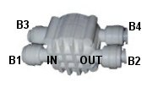
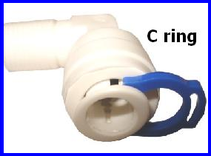
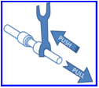
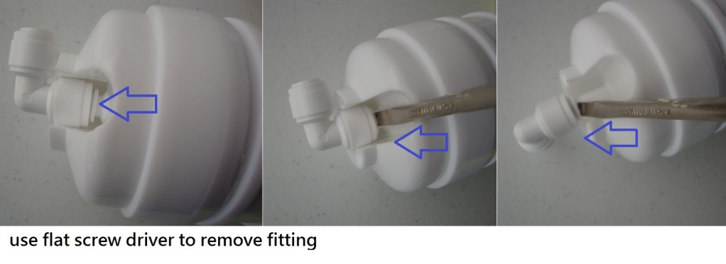
Whole RO System Quick Connectors Diagram Please go to www.purewaterclub.com to see/download the colored version
C3
Post filter 2
C4
Position | Parts number | Connection
A1 | PT-4040Q | incoming water source in
A2 | PT-4040Q | 1th stage out
A3 | PT-4040Q | 2nd stage in
A4 | PT-4040Q | 2nd stage out
A5 | PT-4040Q | 3rd stage in
A6 | PT-4040Q | 3rd stage out
B1 | PT-ASOVQ | to 3rd stage out
B2 | PT-ASOVQ | to RO membrane
B3 | PT-ASOVQ | to check valve
B4 | PT-ASOVQ | to 5th stage
B5 | PT-4040Q | RO membrane in
B6 | PT-CV | Check valve to ASOVQ
B7 | PT-1144Q | to Flow Restrictor
B8 | PT-WASH | Flow Restrictor In (waste water)
B9 | PT-WASH | Flow Restrictor out, to drain
C1 | PT-4040Q | 5th stage in
C2 | PT-4040Q | 5th stage out
C3 | PT-4040Q | 6th stage in
C4 | PT-4040Q | 6th stage out, pure water output
C1
C2
Post filter1
B7
B8
B9
B5
B6
RO filter
B3
B4
B1
B2
A6
A5
A4
A3
A2
A1
Pre-filter3
Pre-filter2
Pre-filter1
Before you connect this RO, you must learn how to properly connect/disconnect quick push-in fittings. The fitting CAN get damaged if inserted tubes are pulled out by force.
If the fitting comes with a C ring on it, remove it first.
TO CONNECT
1
Insert tube all the way into the socket (push it in)
2
Try to pull the tubes to check for security.
TO DISCONNECT
Optional: You may find a collet release tool (fork) to be useful.
To disconnect, all you need is to push on the collet, then pull out the tube.
If using a fork (release tool), push it against the collet. Then pull out the tube.
Notes:
P3

Slide 17
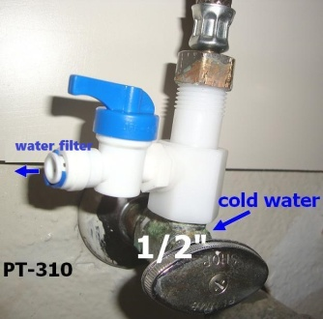
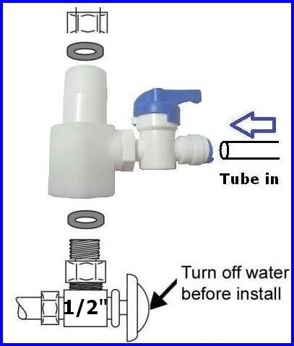
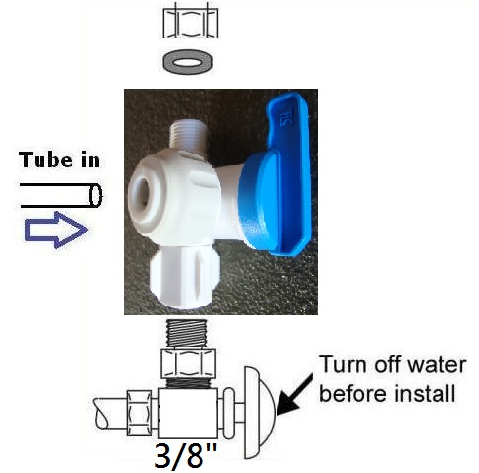
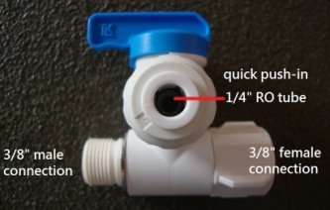
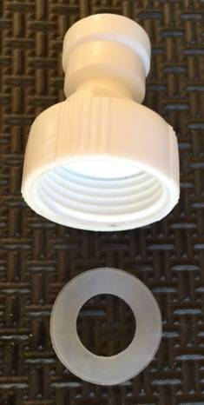
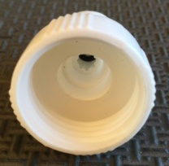
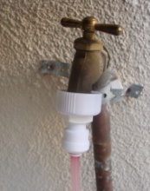
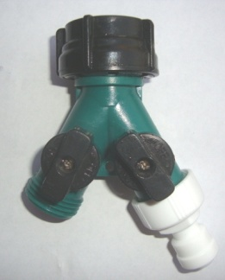
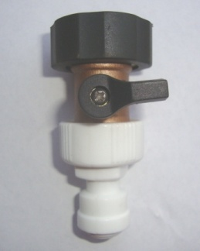
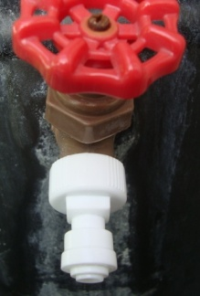
Installation Guide
Installation Step 1: Assembling Water Feeder Simple plumbing knowledge and ability is required to install the system (or you may hire a plumber). You may need a towel, bucket, 2 adjustable wrenches, Teflon tape, screwdriver, and drill.
UNDER-SINK (OPTIONS A, G)
1/2“ (or 3/8”) inlet 1/2“ (or 3/8”) outlet 1/4" RO tube with ball valve
Works for kitchen/bathroom under sink 1/2“ (or 3/8”) shut off valve
PT-310
1) Find the shut-off valve under-sink (cold water only) turn off the water and remove the faucet supply hose from the valve.
2) Measure the inner diameter of the pipe (3/8” or 1/2”.)
3) Wrap some Teflon tape on the thread.
A
PT-38BV
G
Install water feeder as picture, make sure the O-ring is inserted in the proper position. Use some Teflon tape on the thread.
GARDEN HOSE / LAUNDRY (OPTION B)
PT-Q34A
B
garden brass hose bibb/spigot or laundry plastic split adapter
3/4" inlet 1/4" tube outlet
make sure to insert o-ring into proper position (see left)
can screw on the adapter by hand (no tools required)

Slide 18
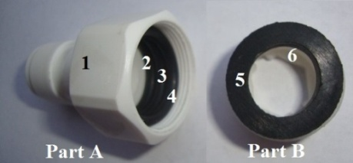
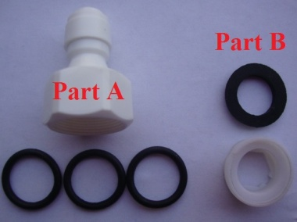
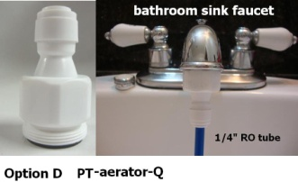
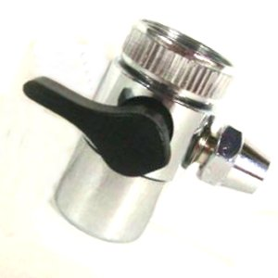
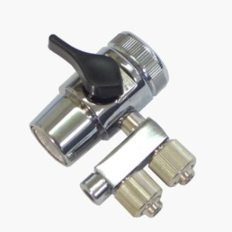
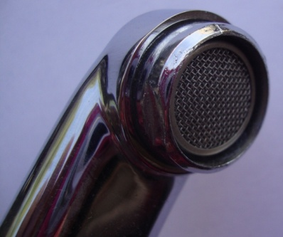
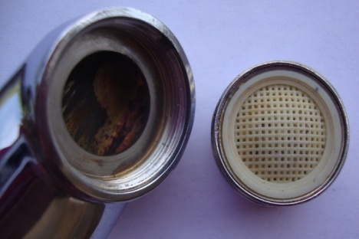
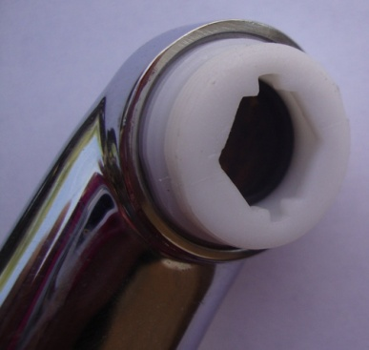
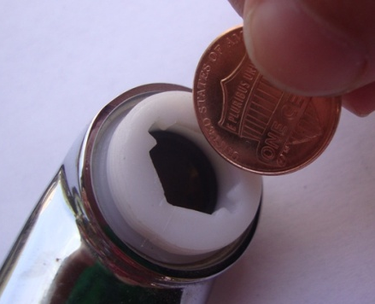
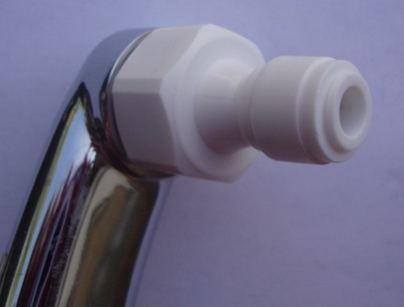
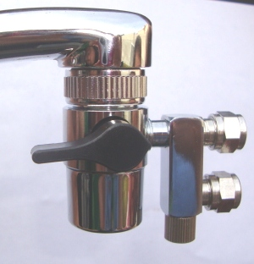
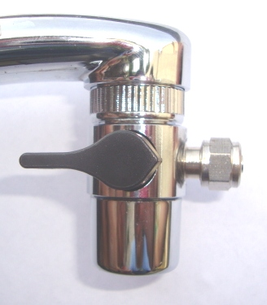
SINK FAUCET (OPTIONS D, E, F)
Kitchen/bathroom sink faucet adapter
PT-aerator-Q
Aerator faucet connector
D
Assemble
faucet adapter with 1/4” quick connection
3 black o-rings for faucet adapter
white female/male converter
black o-ring for converter
PT-2W2
PT-3W2
E
F
Two way switch
Includes a converter + black o-ring (part B)
Three way switch
Includes a converter + black o-ring (part B)
For Options D, E, and F, please assemble as the following:
Bottom-up faucet view.
Remove the spray aerator adaptor from the faucet.
Twist in the converter (Part B.)
Use a coin as a wrench to tighten the converter (clockwise). Avoid using an actual wrench because it can bend/break the converter’s thread.
Twist in the sink adaptor.
1
2
3
4
5
Final product (Options D, E, or F):
D
E
F

Slide 19
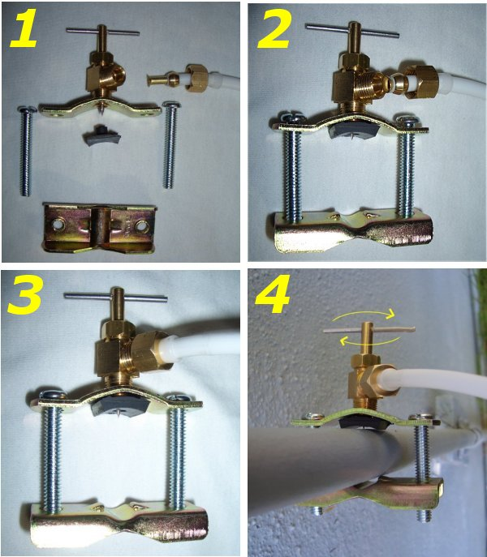
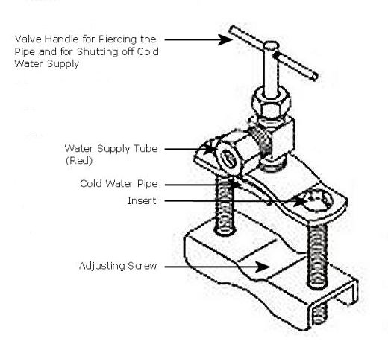
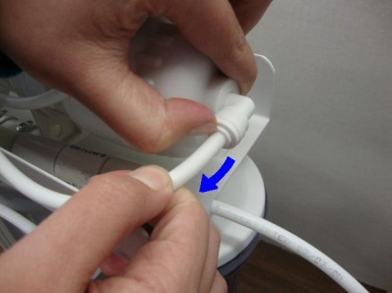
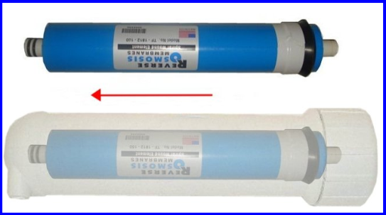
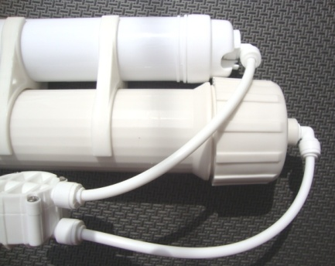
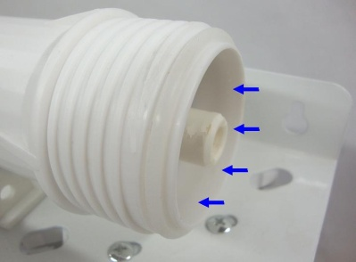
NEEDLE VALVE (OPTION C)
PT-NED
C
for PVC pipe only
Please assemble as pictured:
Installation Step 2: Inserting the RO Membrane
If membrane housing already has the fitting and tube connected, remove tube from RO housing
Take out the membrane from the clear plastic wrapping, then insert membrane into housing (the end with 2 black rings go in first)
O-ring
The membrane must be inserted all the way to the end. You must be able to twist on the cap completely.
Twist on the cap of the housing, then re-connect the tube from auto shut off valve.
Important: The membrane housing should come with a white O-ring. The sticky grease on it is Vaseline, which will prevent leaking. If the ring is missing, water will leak from the housing.
Please contact us if you’re missing the O-ring.

Slide 20
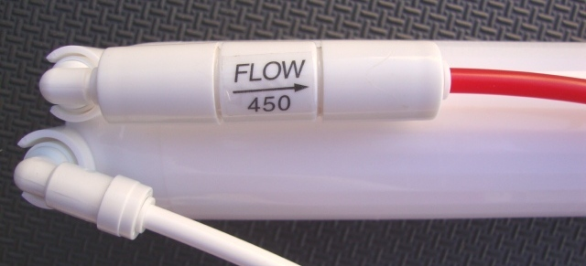
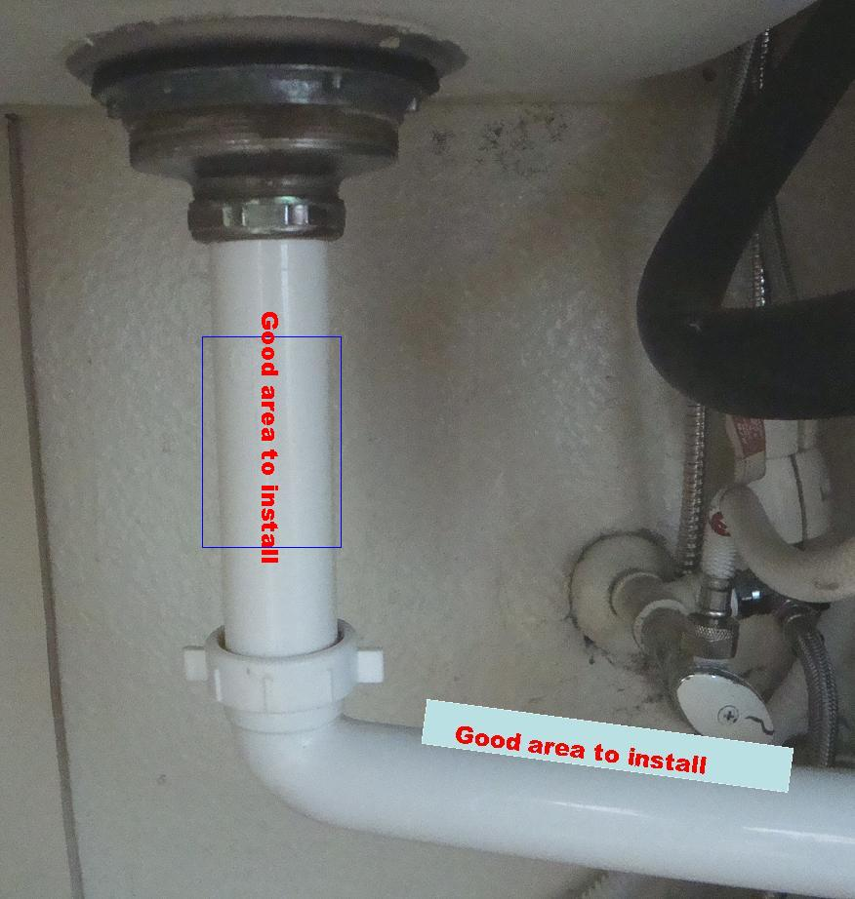
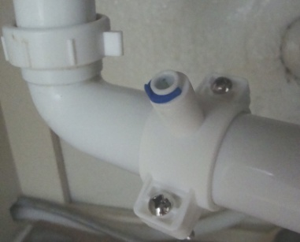
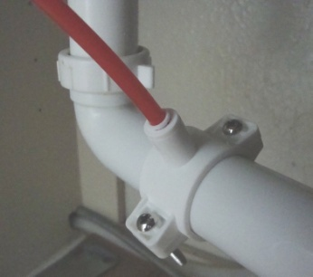
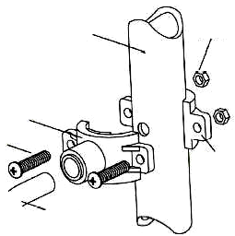
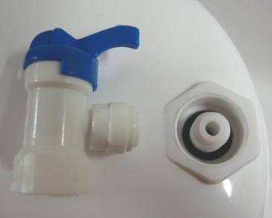
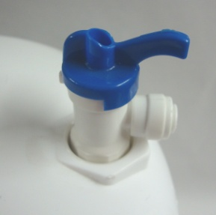
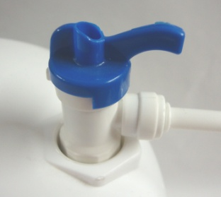
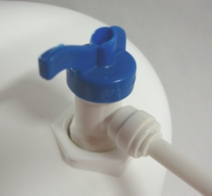
Installation Step 3: Flow Restrictor (Drain)
Important:
The water that comes out from the restrictor is WASTE water, please do not consume. (You may, however, use it to water lawns, wash clothes/cars, etc.)
The other end of the flow restrictor MUST be open and free to flow. It CANNOT be blocked off OR connected back to the RO system as an incoming water source!
Insert the red tube into the flow restrictor. The other end is where waste water comes out. The ratio from pure water to waste water is 1:3.
The Drain Saddle Valve Installation
Remember, you MUST match the hose opening with the drilled hole. Screw in the saddle valve together tightly.
Drain Pipe
¼” Nut
Drain Clamp Front Plate
Drill a 0.3-0.4 mm hole on the drain pipe
DO NOT drill hole on the bottom of the pipe.
DO NOT lead waste water back to water supply.
¼” Screw
Drain Clamp Back Plate
Red Drain Tube
The Pressure Water Tank Installation (optional)
The pressure water tank contains a rubber bladder inside, so the water may taste strange. If using the tank for the first time, please fill it fully with water then drain it out for at least 3 times to clean it out.
Opening on the top and valve
Screw in the valve
Valve open position
Valve close position
Notes:
p2

Slide 21
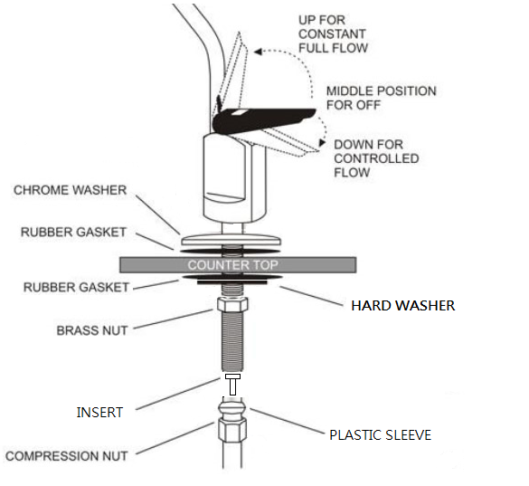
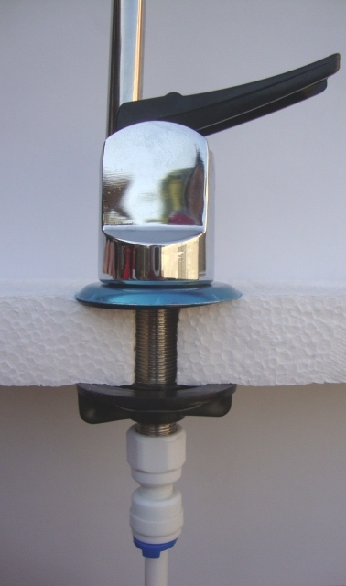
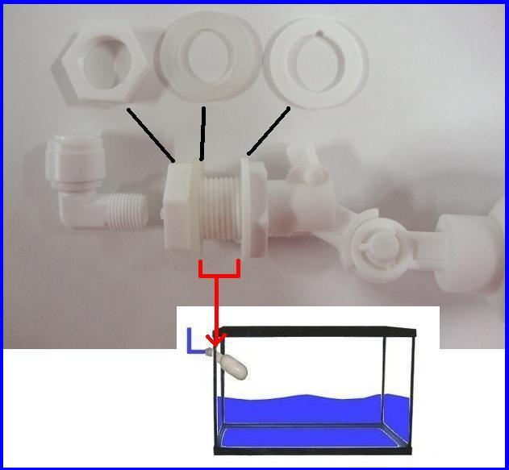
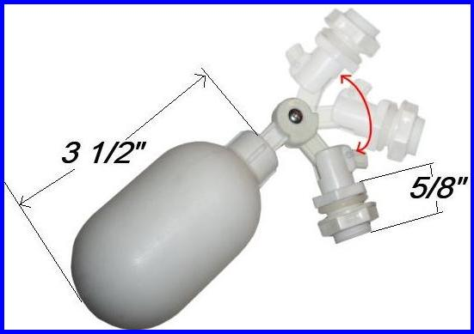
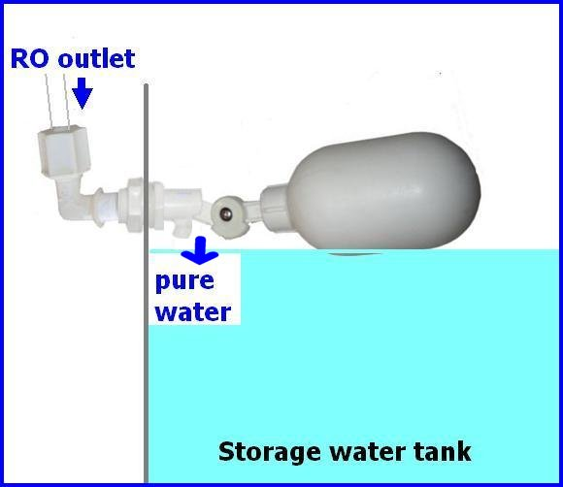
Long Reach Faucet Installation (optional)
Quick installer kit (PT-LQfaucet) available on our store (optional)
Most sinks have an extra hole for the mounting of additional faucets, sprayers or soap dispensers. If your sink does not already have an additional hole, you may need to drill 1 " hole on the countertop. Carefully mark the faucet location, making sure it is far away enough from the regular water faucet so that they don't interfere with each other. Look to see if you can tighten the lock nut from below, before you drill a hole. Once the hole is prepared, assemble all parts together.
The Floating Valve Installation (optional)
Floating valve can be adjusted by using a screwdriver to any angle you want. Drill a hole on the tank where you want the water line to be reached.
Installation Step 4: Flushing the RO System
Check to see if all the tubes and fittings are secured properly.
Turn on the water source and check for any leaking. If a fitting is leaking, please go back and reconnect the tube to the fitting. If you cannot stop the leaking, please contact us.
Let about 5-10 gallons of water flush through the system. This way, the pure water will be safe to use.
DO NOT consume the pure water produced in the initial flushing of the system.
Notes:
P4

Slide 22
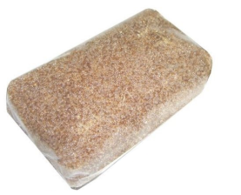
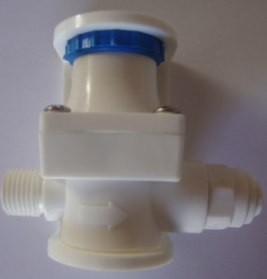
WARNINGS, TIPS, AND USEFUL INFORMATION
For sanitary reasons, you MUST insert membrane by yourself.
Prepare plumbing tools such as wrenches, screwdriver, Teflon tape, protecting eye-glasses, etc.
Only connect the RO with cold water and a clean water source, NO seawater.
Recommended water source TDS reading is not to exceed 1000 PPM.
The RO system should never be placed under direct sunlight or under freezing temperatures if it is placed outside.
Maximum temperature: 113ºF. Minimum temperature: 33ºF.
35 PSI minimum is requited for the RO to operate, at 65 PSI 25°C is best.
If the pressure of the incoming tap water is too low (less than 35 PSI), a booster pump is required.
If water pressure exceeds 85 PSI, a pressure regulator (PT-regulator) must be installed.
The installer is responsible for any leaks resulting from installation of tube or related fittings.
You must check over the entire unit completely while under proper water pressure to ensure that the unit is not leaking and is functioning properly.
Please flush the whole RO system for at least 10-15 gallons, or drain out the water tank at least 3 times for first-time usage.
The RO comes with an auto shut-off valve. An auto shut-off valve only works with a float valve, or any CLOSED container such as a pressure tank, an ice maker, etc. If the container is not closed, then you have to turn off the incoming water manually.
All RO systems will create waste water. Most RO systems are designed for 1:(3.5 - 4.5) as standard. We used a 450 Flow Restrictor; the ratio from pure to waste water is 1:3.
Replace all pre-filters and post-filters per 6-12 months, depending on the water source's quality.
Replace membranes per 1-2 years.
Change the DI filter per 500 gallons.
OTHER PRODUCTS
Want to get creative and customize your RO system with more efficiency?
Here we have more products, some handy/useful parts and tools, that will allow you to make things easier for you as you install your RO system. Please note that all products in this section are sold separately.
Refillable DI Resin/Cartridge (OT-RES-HOUDI)
Pressure regulator (PT-regulator)
(PT-LQfaucet)
Pressure Gauge (PT-PSI-150)
Float-Valve Bracket Kit (PT-FVBS)
TDS Meter (PT-TDS-1)
We also offer many other connectors and adapters to suit your personal RO needs.
Please email us at rosales@purewaterclub.com!

