Slide 1

Model No: NR5-T
REVERSE OSMOSIS SYSTEM
INSTALLATION MANUAL

Slide 2
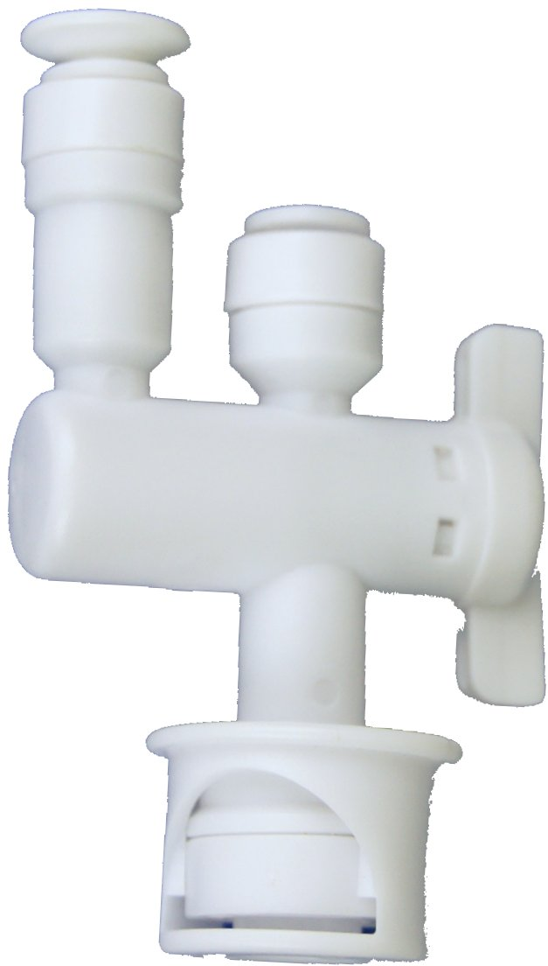
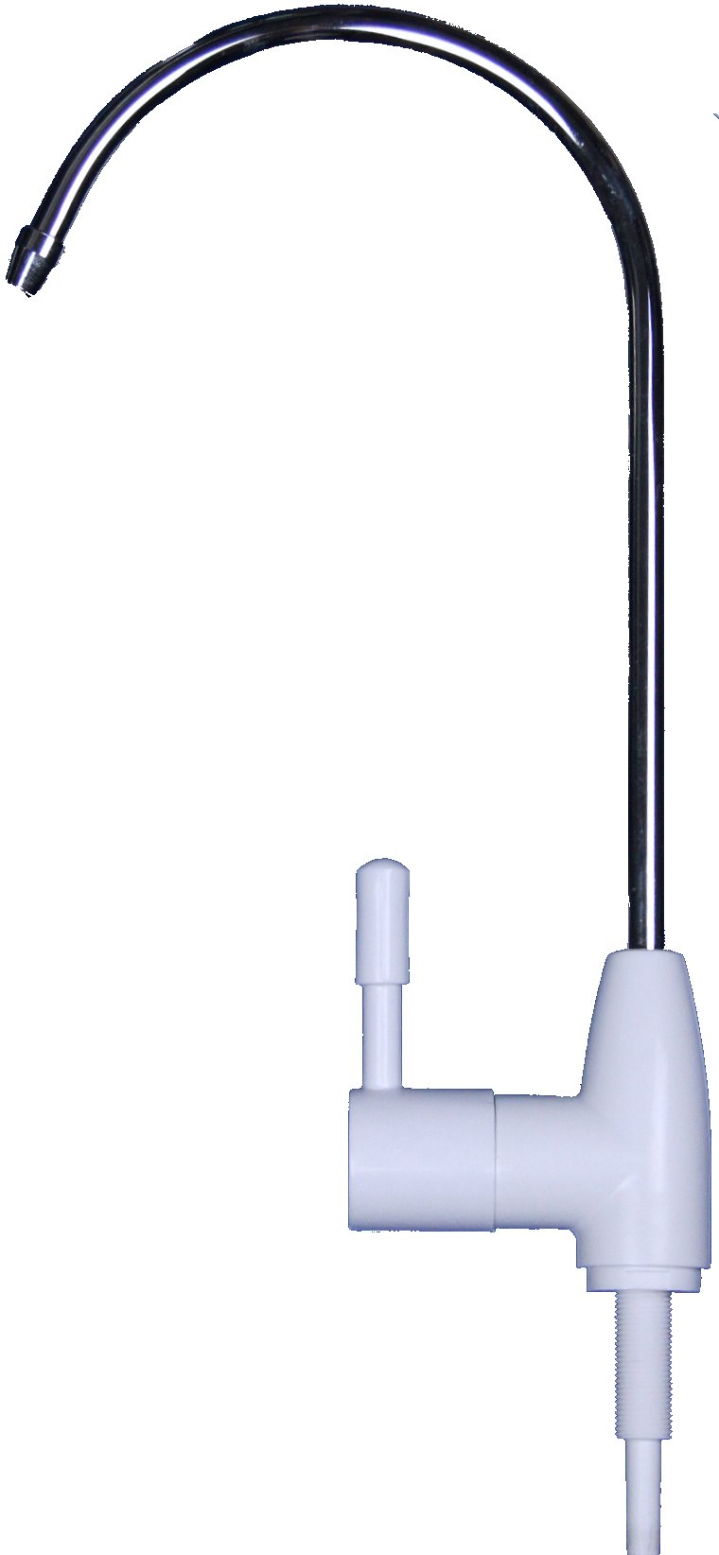
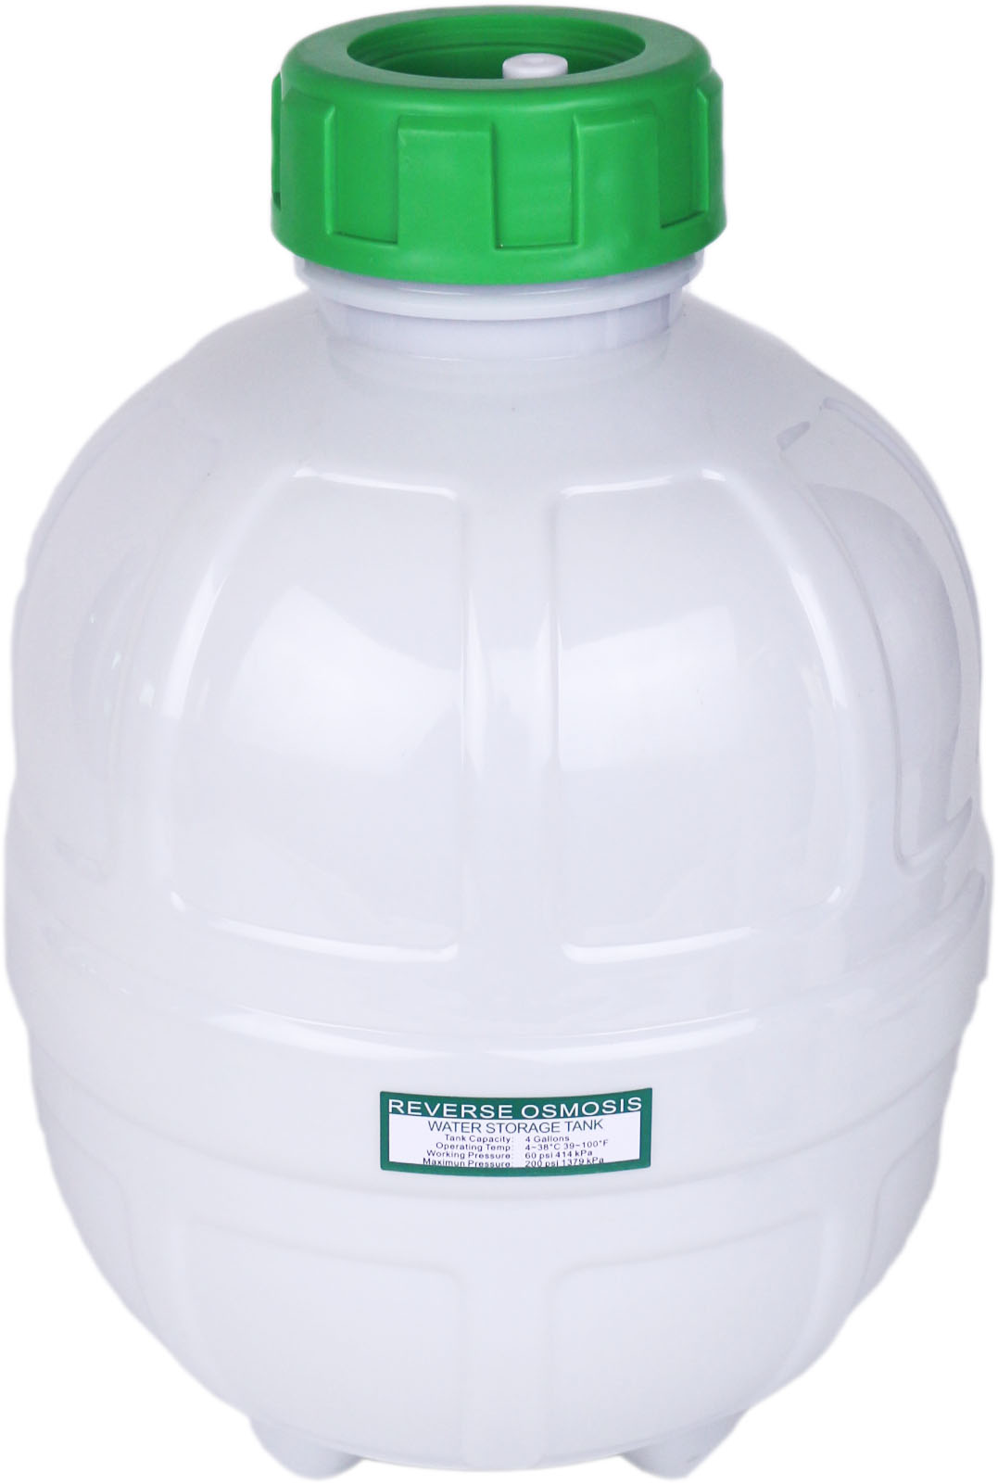
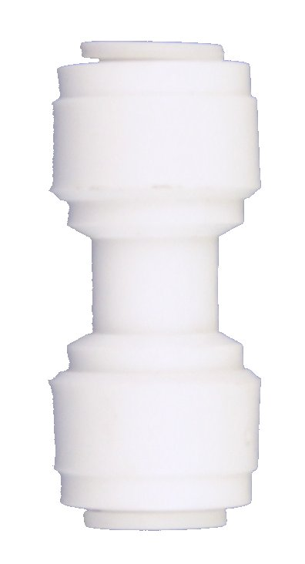
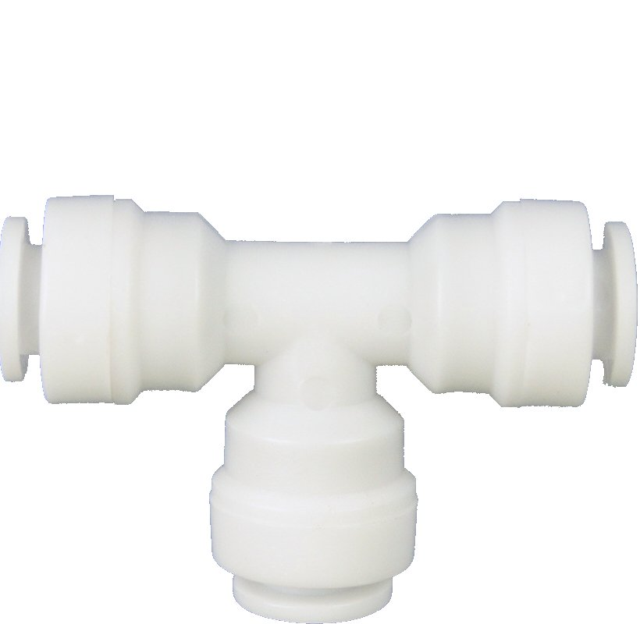
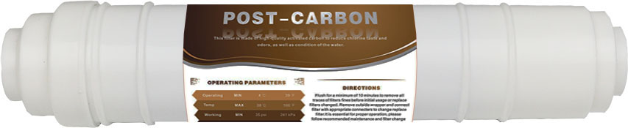
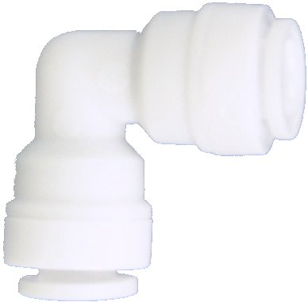
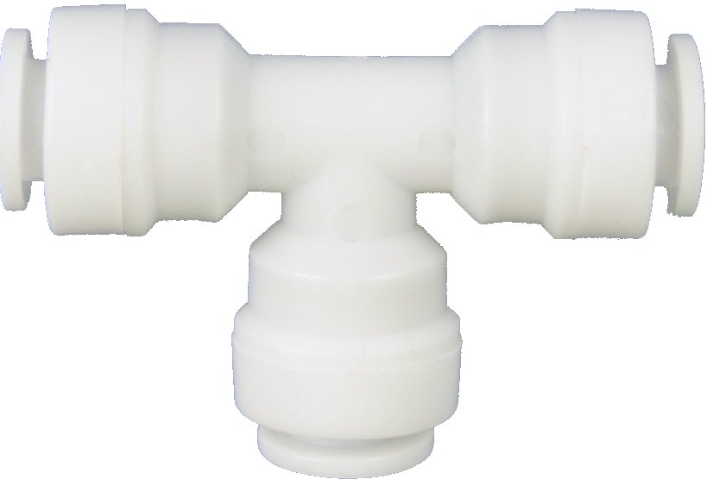
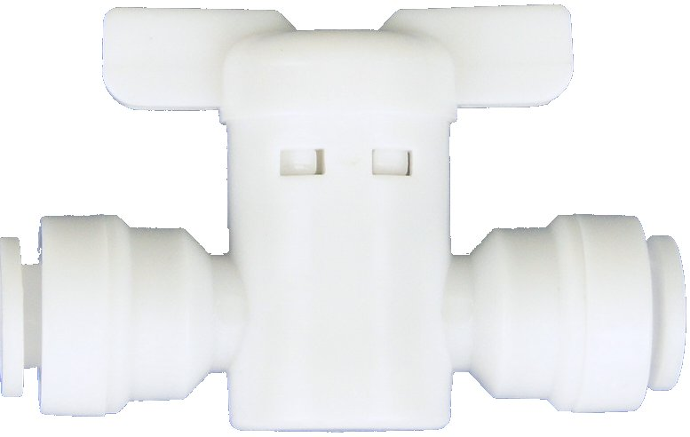
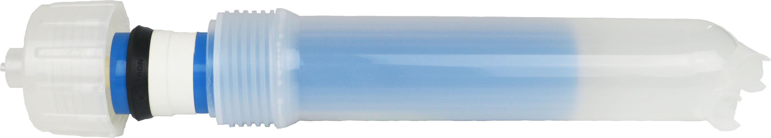
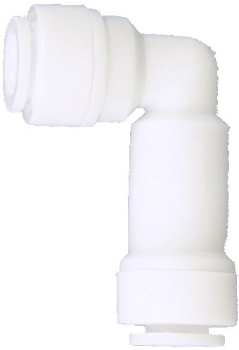

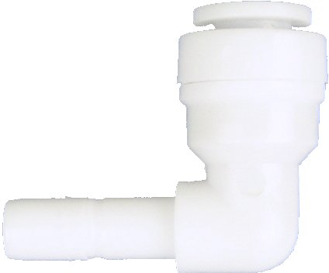
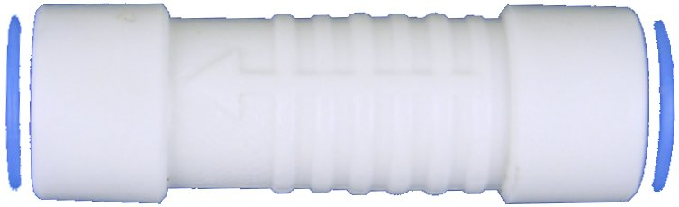
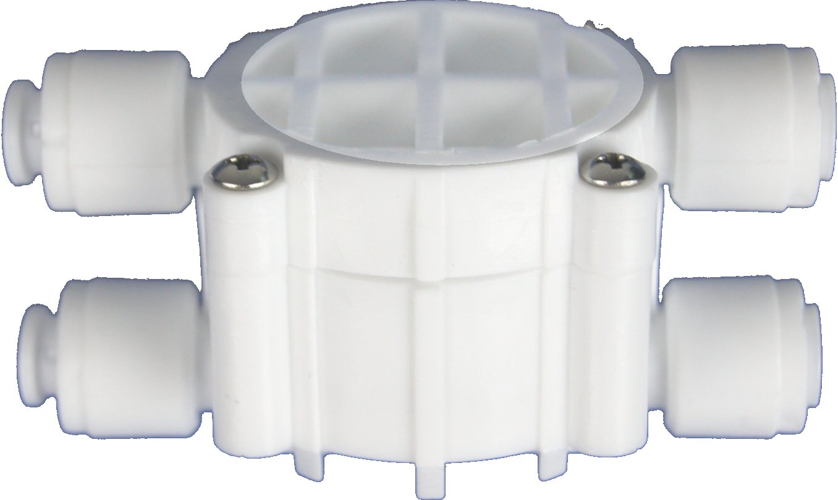

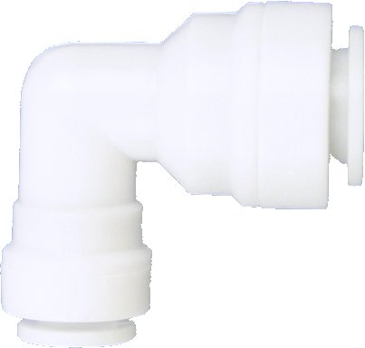
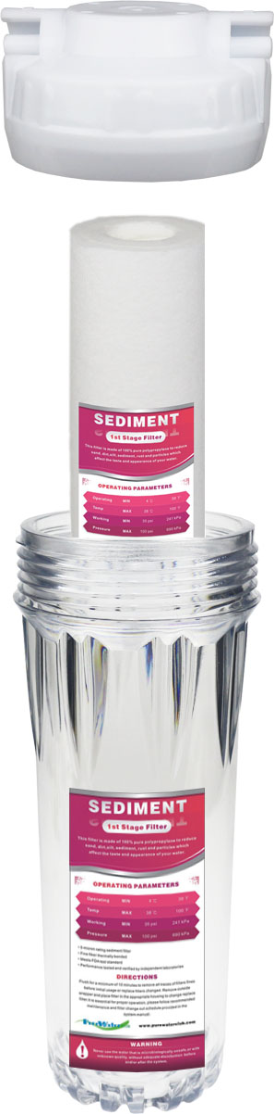
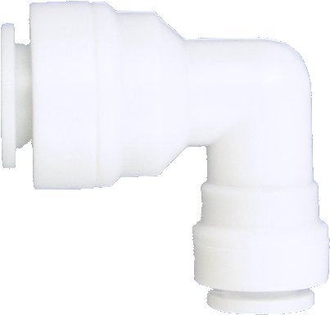
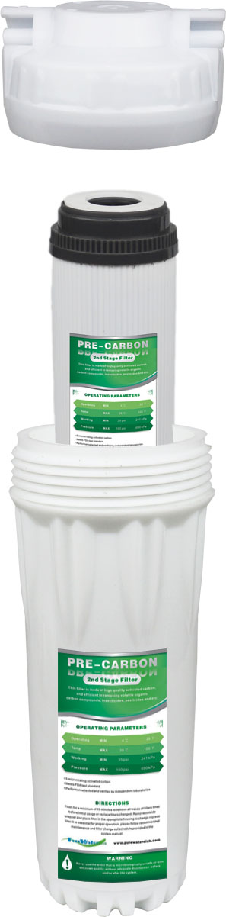
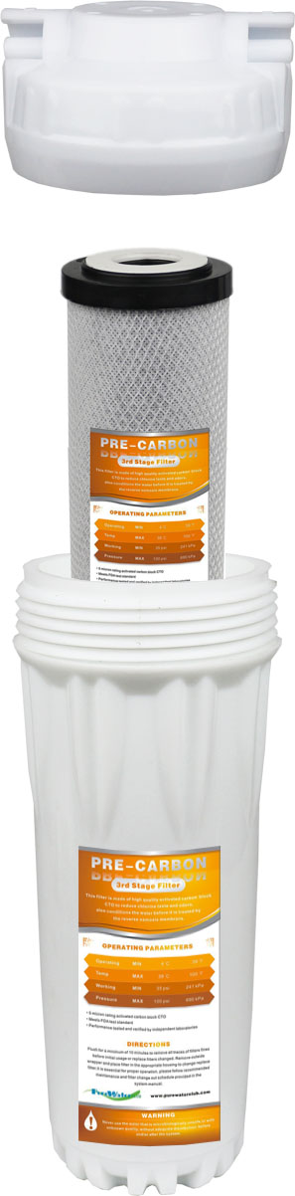
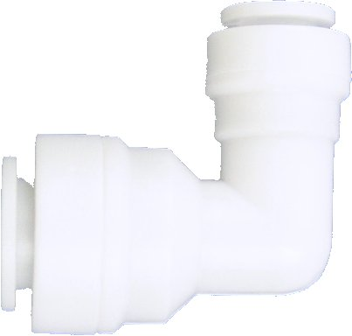
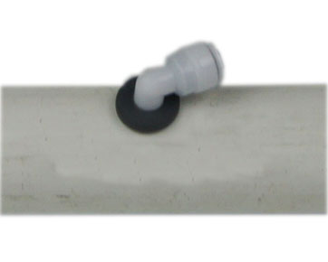
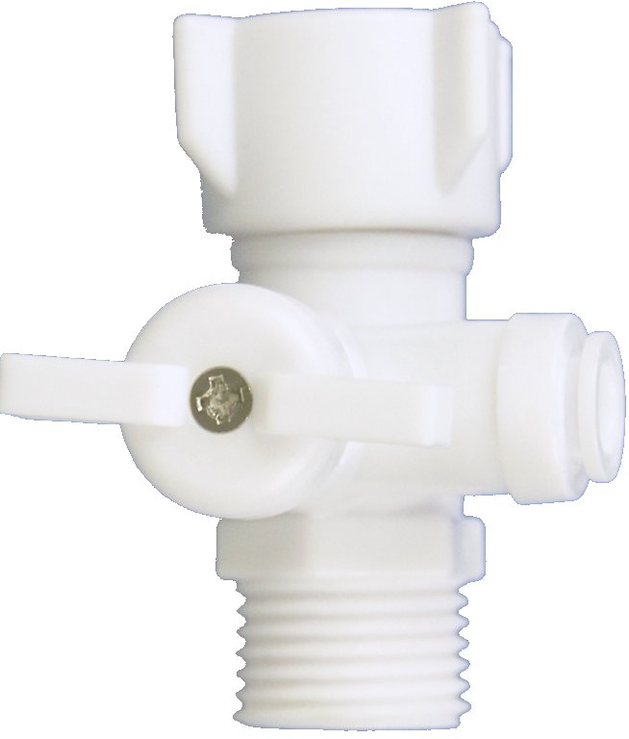
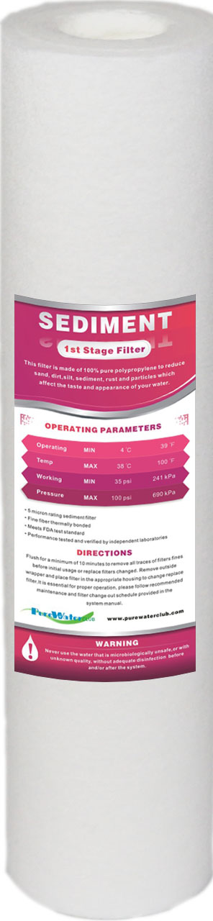
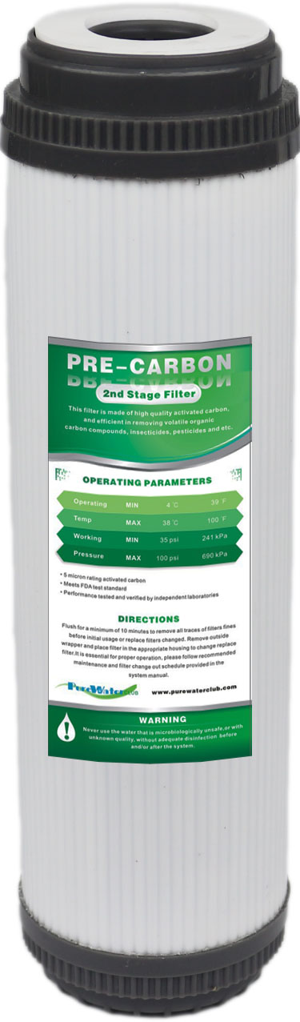
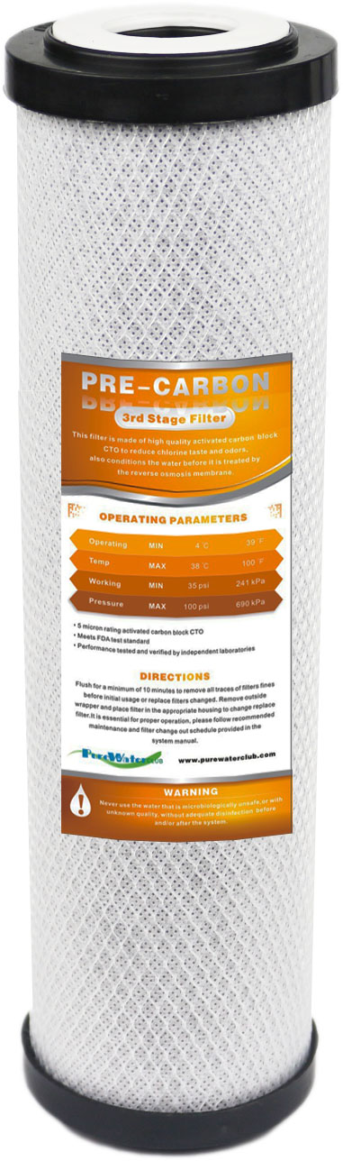
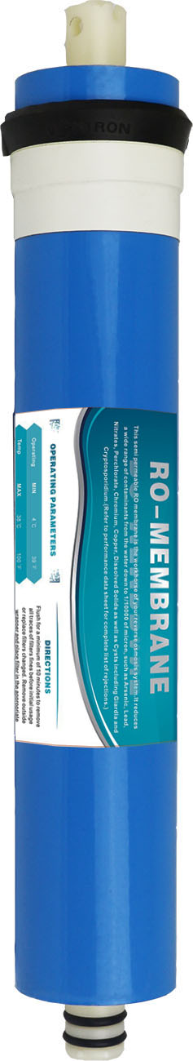
RO SYSTEM DIAGRAM
FILTERS / CONNECTERS / PARTS
20
23
1.Feed Water Adapter
2.1st Pre-Filter Housing
3.2nd Pre-Filter Housing
4.3rd Pre-Filter Housing
5.Sediment Water Pre-Filter
6.GAC Carbon Pre-Filter
7.Carbon Block Pre-Filter
8.Elbow 1/4“ 3/8” (6040Q)
9.Tee 1/4“(702Q)
10.Automatic Shut-Off Valve
11.Front-RO-In Ball Valve
12.Back-Drain-Out Ball Valve
13.Elbow 1/4“ (4040Q)
14.RO Membrane Housing
15.RO Membrane
16.Check Valve
17.Stem Elbow 1/4“ (1144Q)
18.Drain Flow Restrictor
19.Inline GAC Post-Filter
20.Tank Ball Valve
21.Water Storage Tank
22.Faucet Quick Fitting(154Q)
23.Pure Water Faucet
24.Drain Three-Way Adapter
25.Drain Two-Way Adapter
26.Drain Hose Coupler
27.Stainless Steel Hose Clamp
28.Drain Rubber Plug With Elbow
21
22
9
19
13
9
12
28
13
15
14
16
27
26
24
11
10
18
17
9
27
25
26
28
8
8
8
8
8
8
28
5
6
7
1
2
3
4
1
2
3
4
5
Filter Stages
Sediment
GAC Carbon
Carbon Block
RO Membrane
Inline GAC
Filter Change
Out Schedule
6-12
months
6-12
months
6-12
months
1-2
years
6-12
months

Slide 3
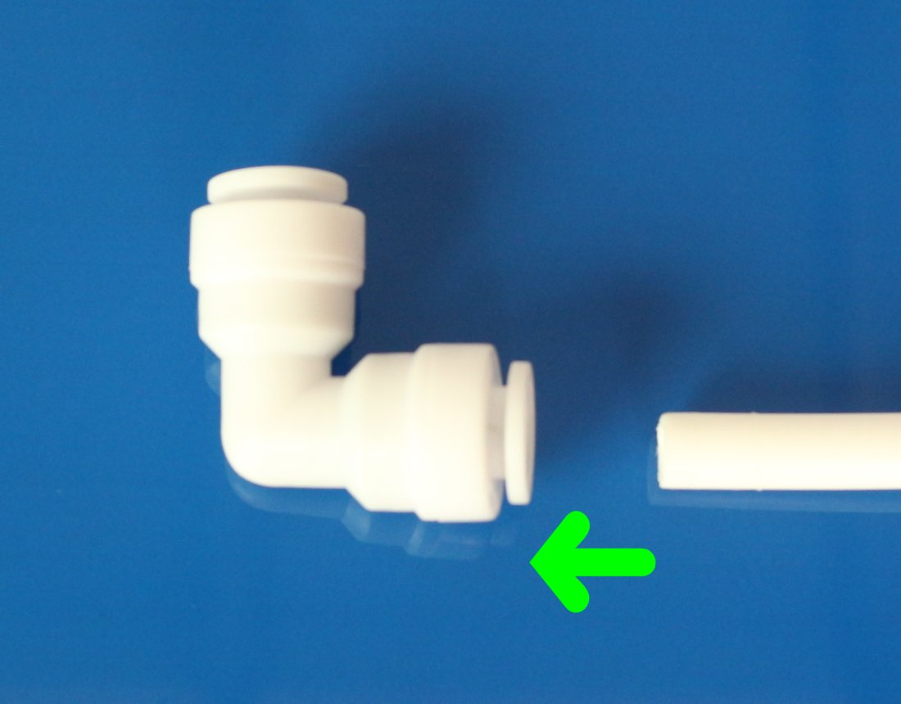
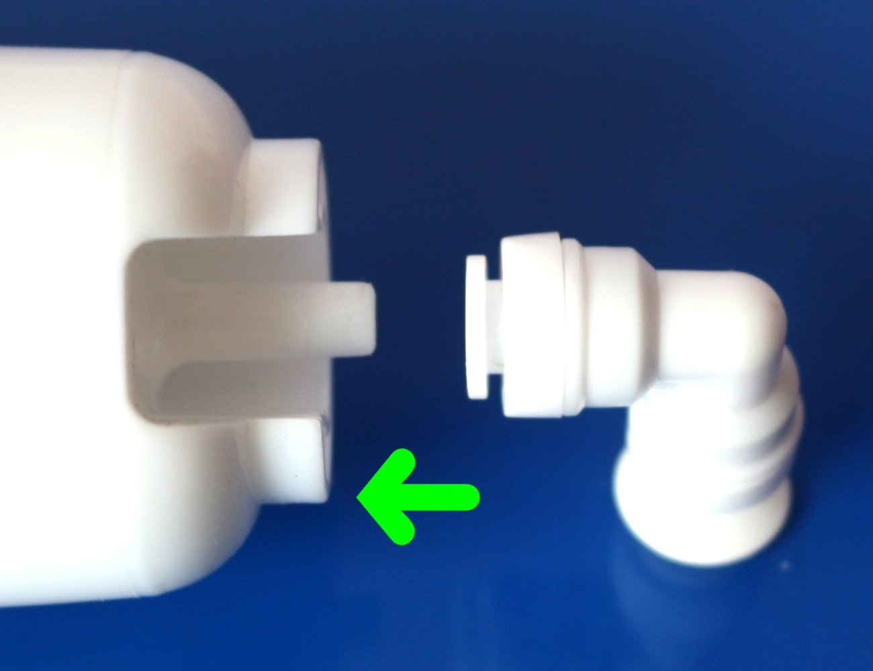
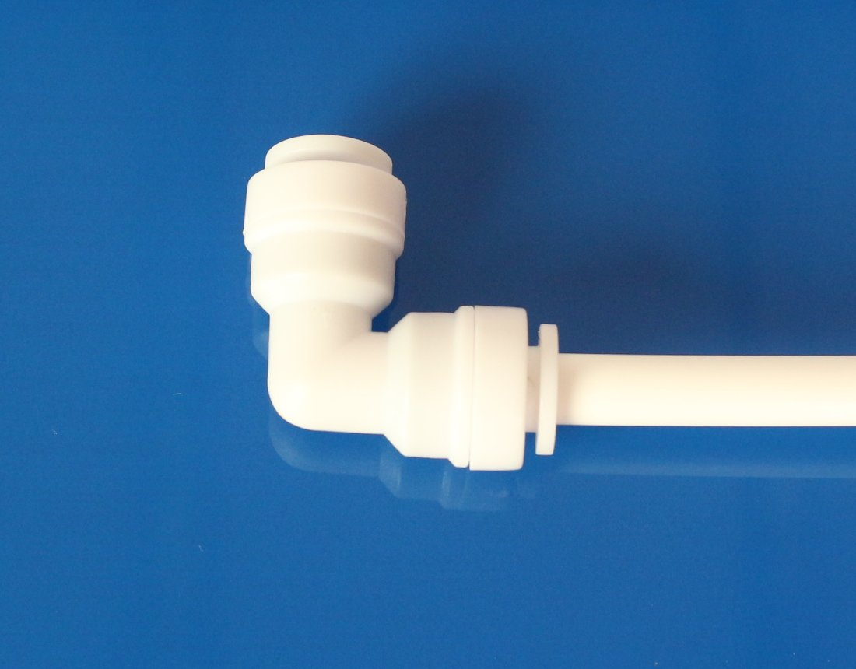
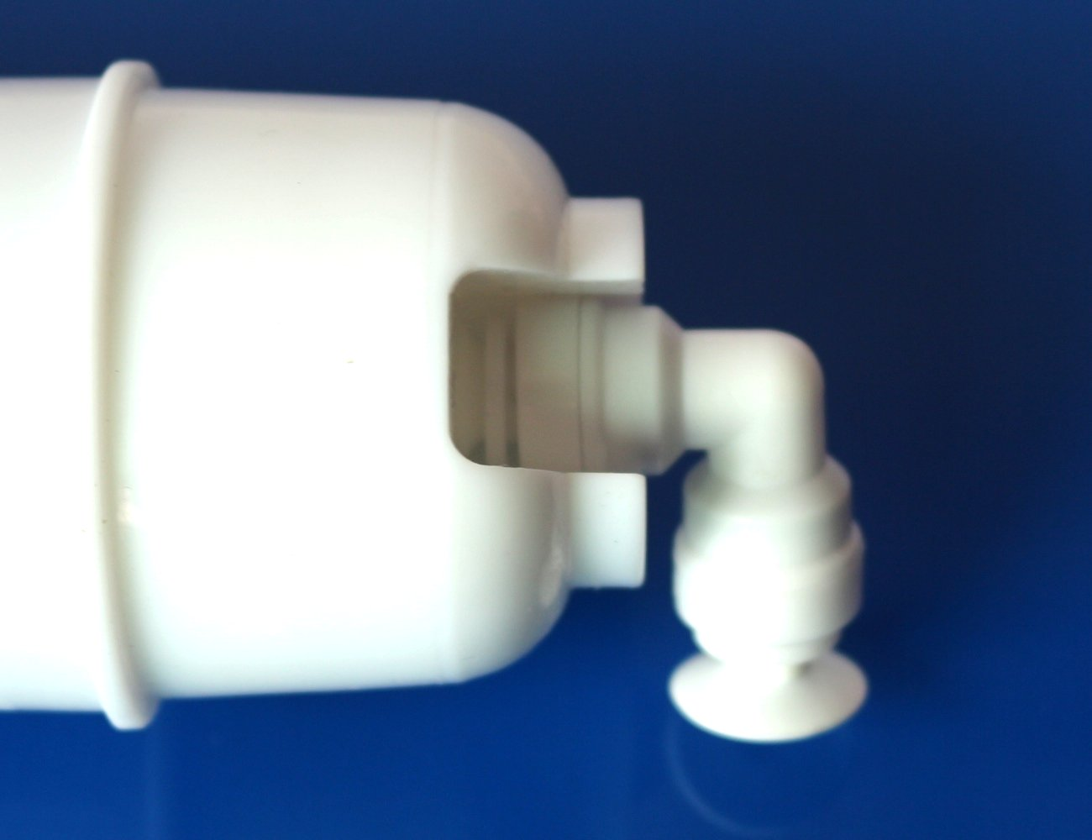
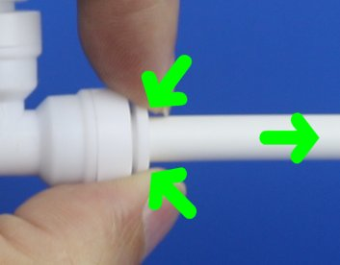
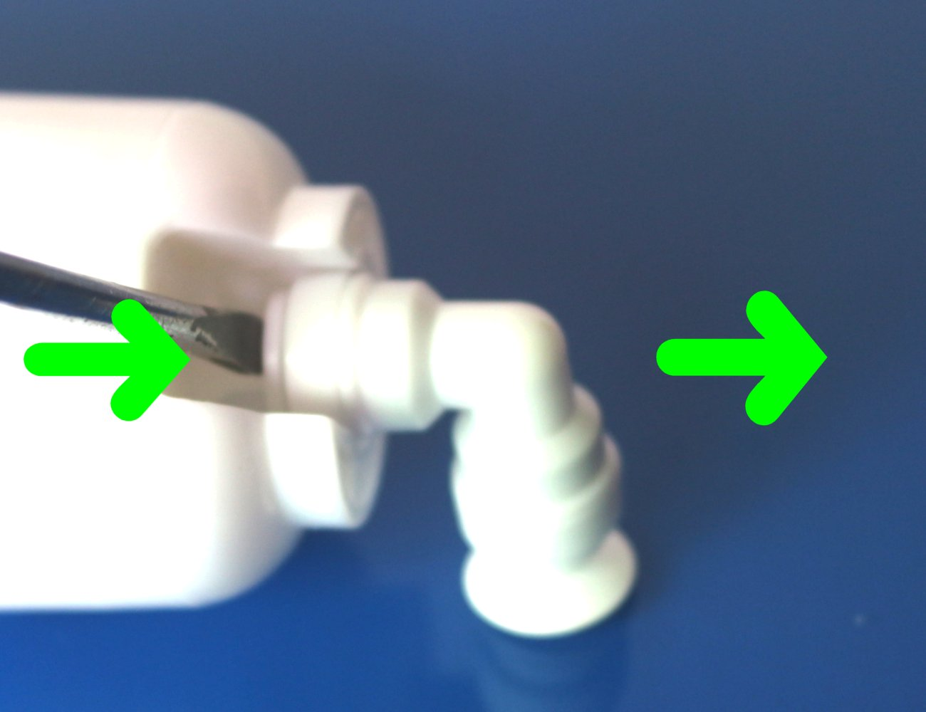
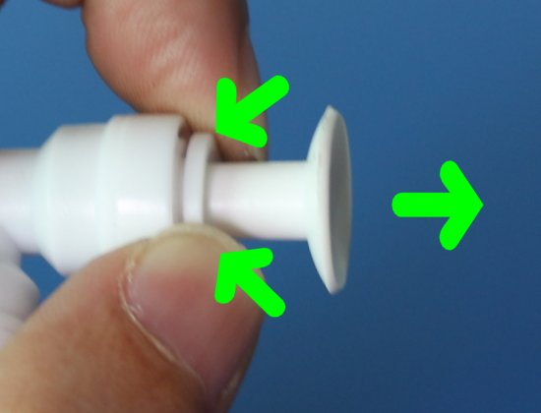
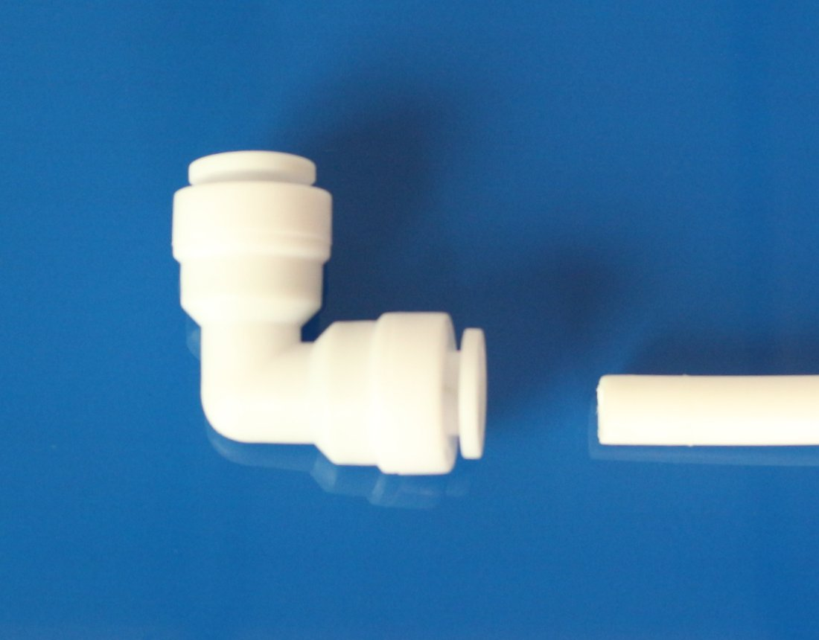
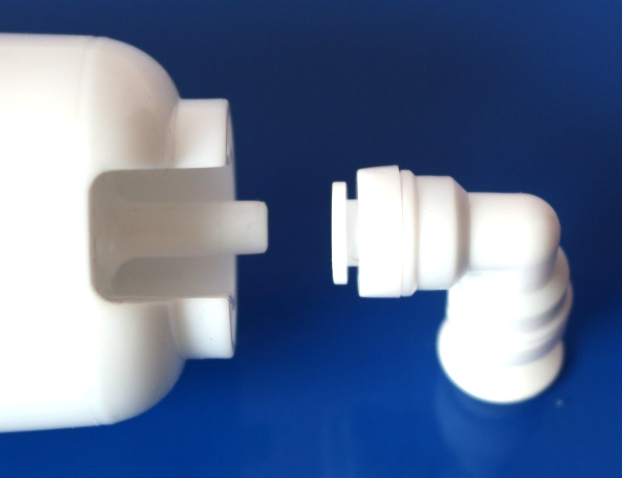
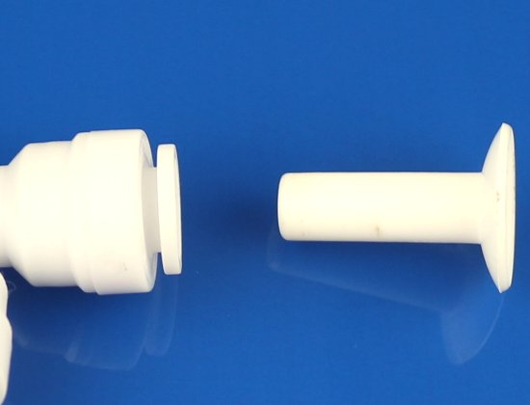
INSTALLATION STEP 1
QUICK CONNECT GUIDE
Before you install the system, you must learn how to properly connect/disconnect quick push-in fittings. The fitting CAN get damaged if inserted tubes are pulled out by force.
TO CONNECT / ATTACH
Push tube / fitting straight in as far as it will go.
TO DISCONNECT / RELEASE
Push in collet by finger or the flat screwdriver, then pull tube / fitting / stopper out to release.

Slide 4
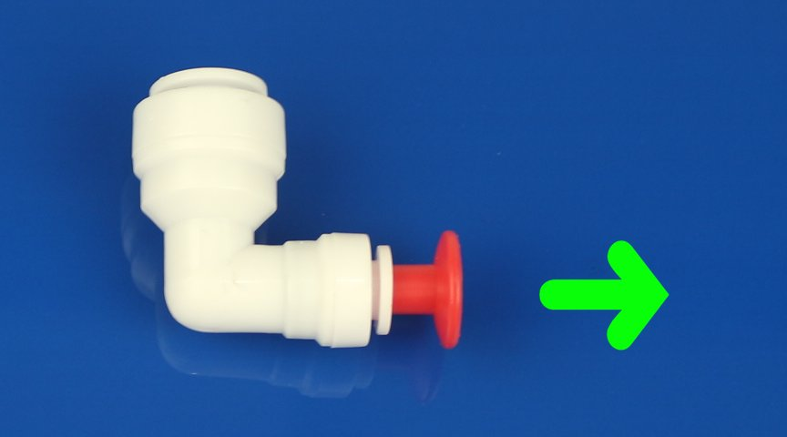
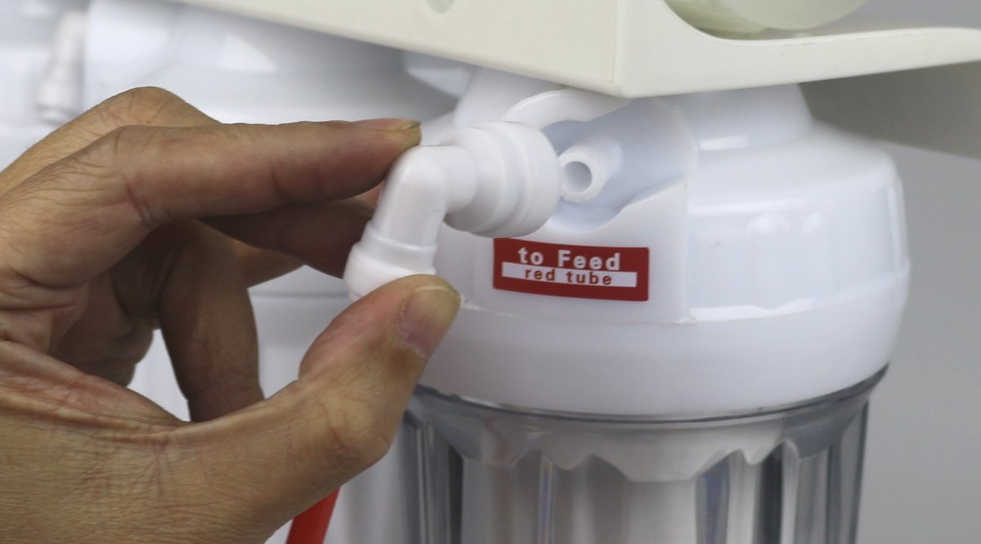
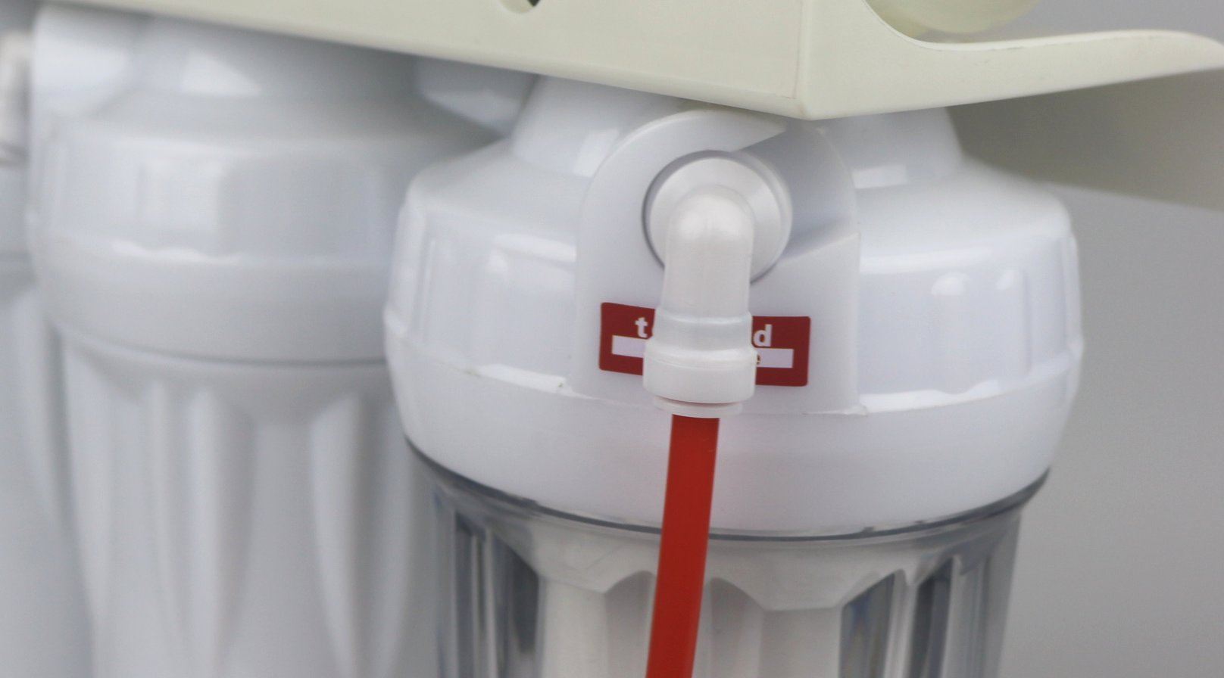
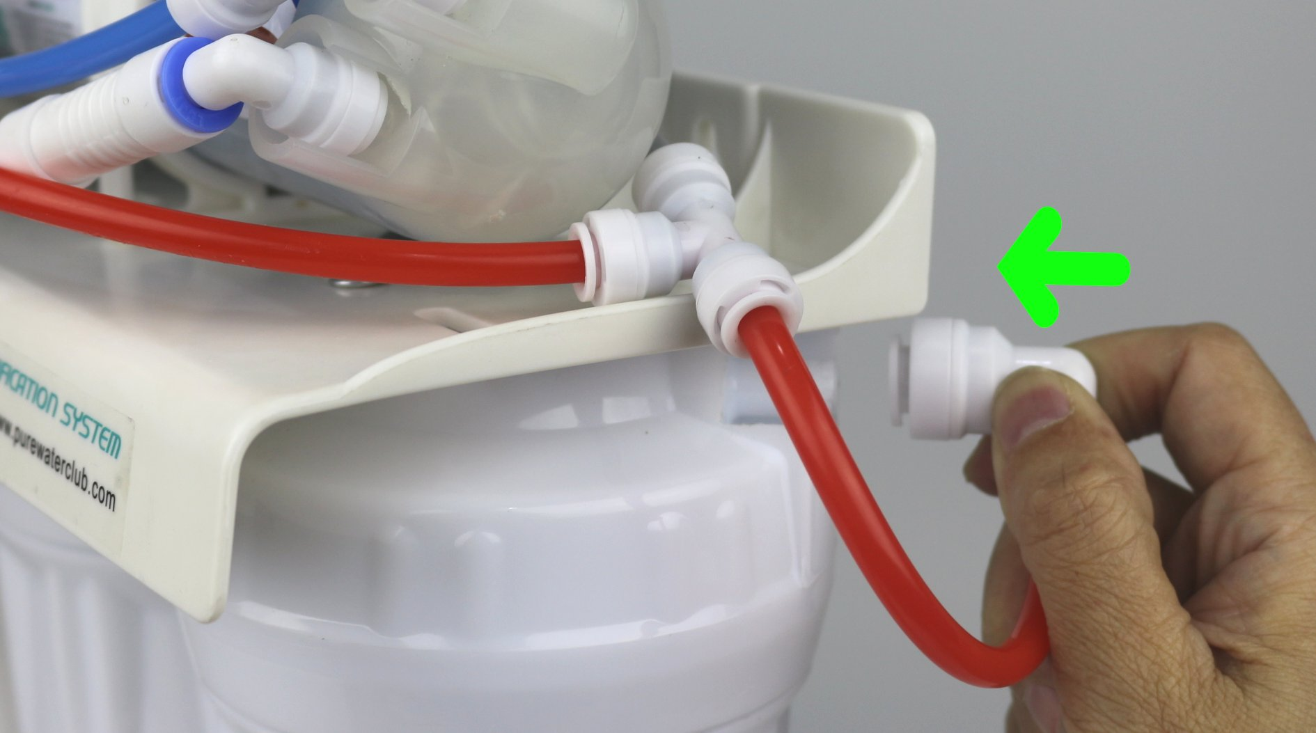
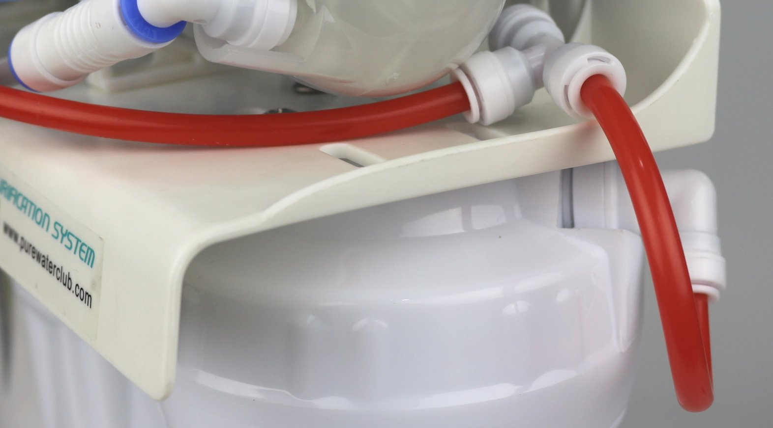
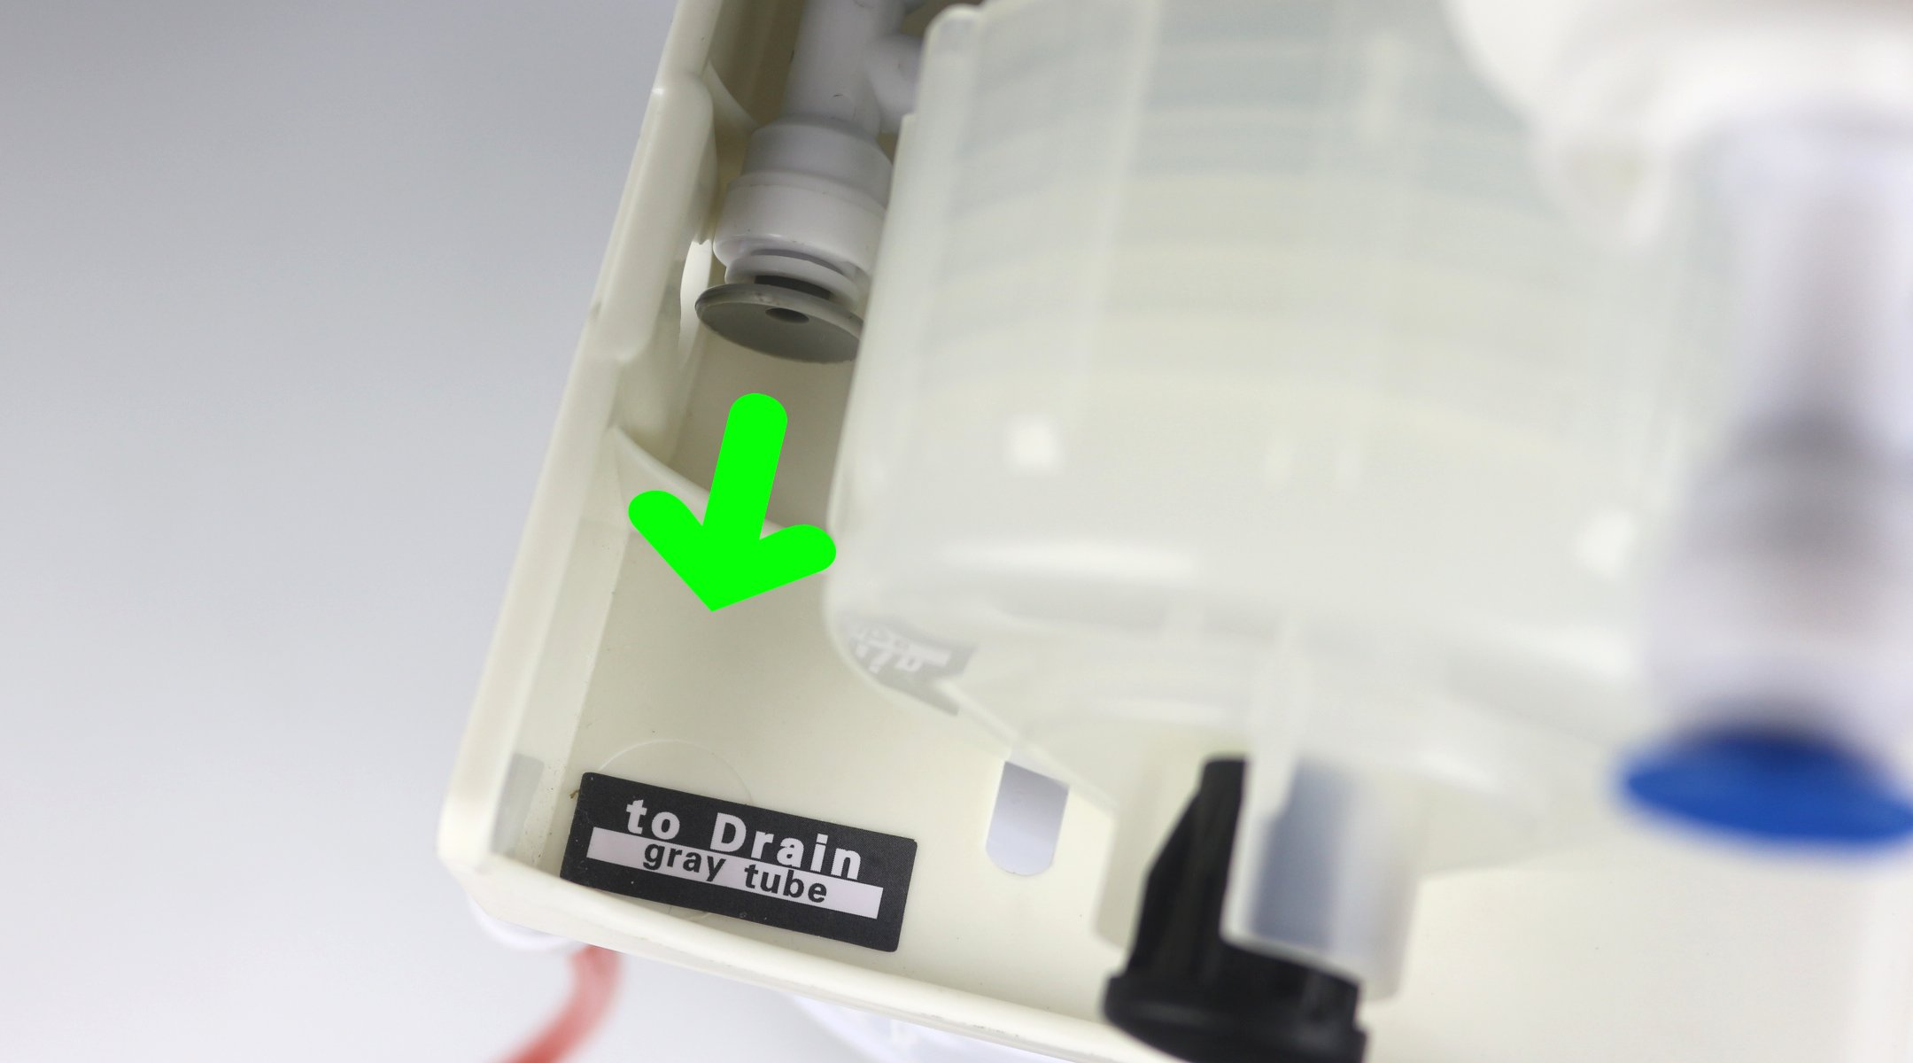
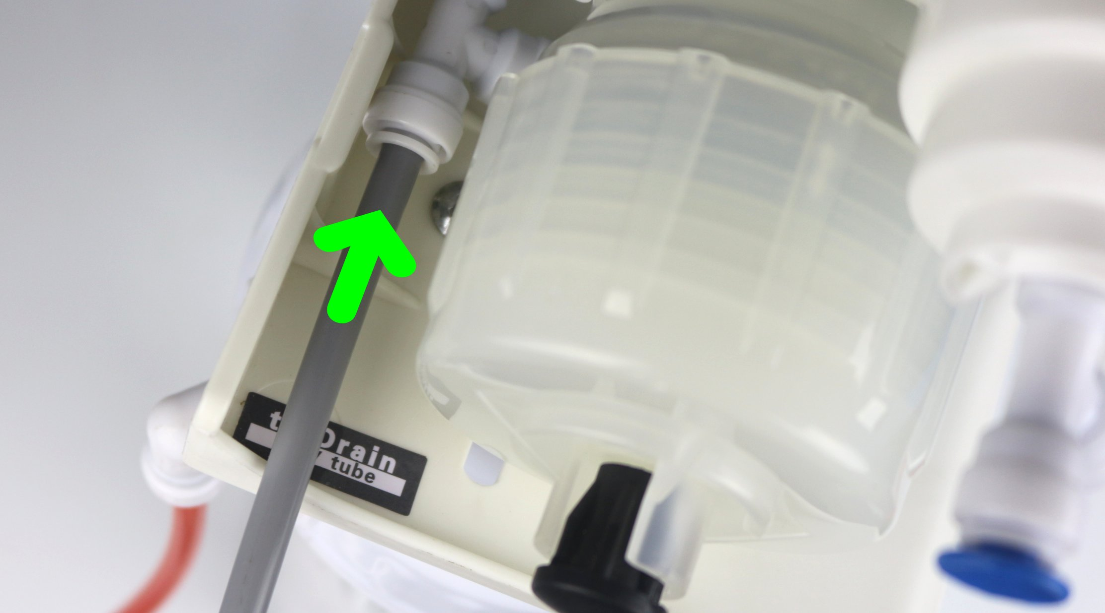
INSTALLATION STEP 2
INITIAL FITTING CONNECTION
Find the elbow fitting (1/4” 3/8”) with the red stopper in the provided parts bag. Find the 5 feet feed water tube (red color ).
Remove the red stopper from the elbow fitting. Insert the 5 feet feed water tube (red color ) into the 1/4” end of the elbow fitting.
Fully insert the 3/8” end of the elbow fitting with the 5 feet red color tube into the end of the left hand side clear filter housing.
Find the right hand side elbow fitting (1/4” 3/8”) with the red color tube and the tee fitting.
Fully insert the 3/8” end of the elbow fitting with the red color tube and the tee fitting into the end of the right hand side white filter housing.
Find the left hand side drain tee fitting with the gray stopper and two gray color tubes behind the RO membrane housing. Find the 5 feet drain tube (gray color ).
Remove the gray stopper from the drain tee fitting. Insert the 5 feet drain water tube (gray color ) into the end of the tee fitting.

Slide 5
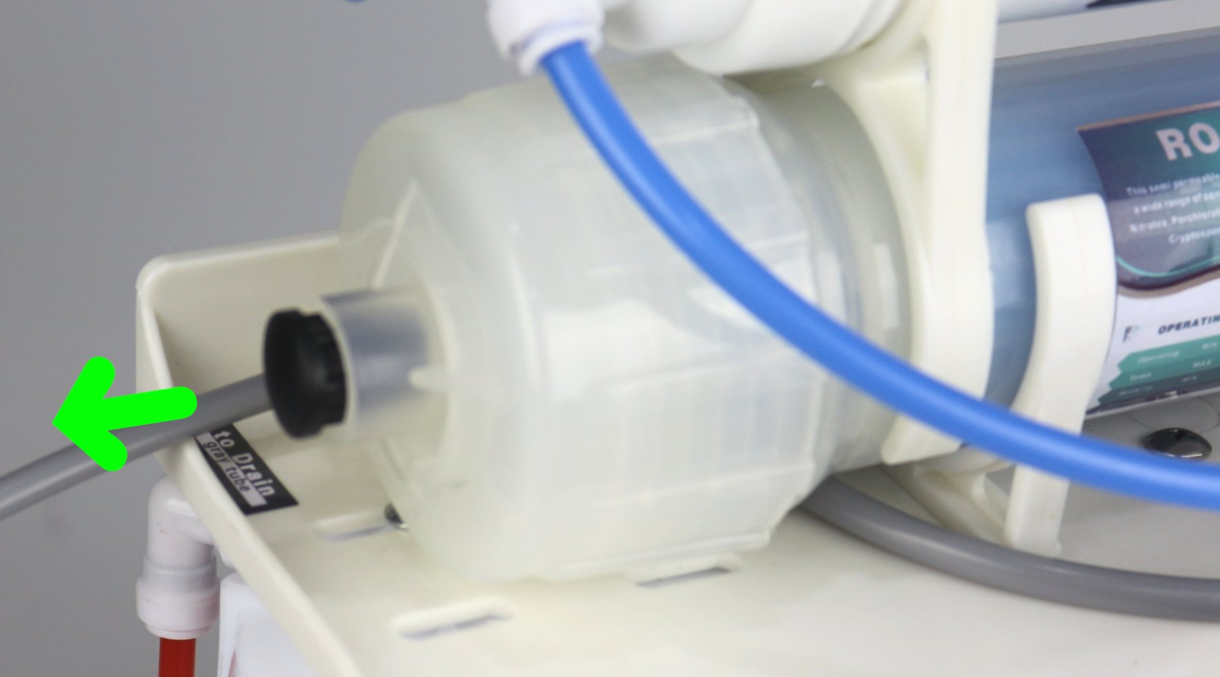
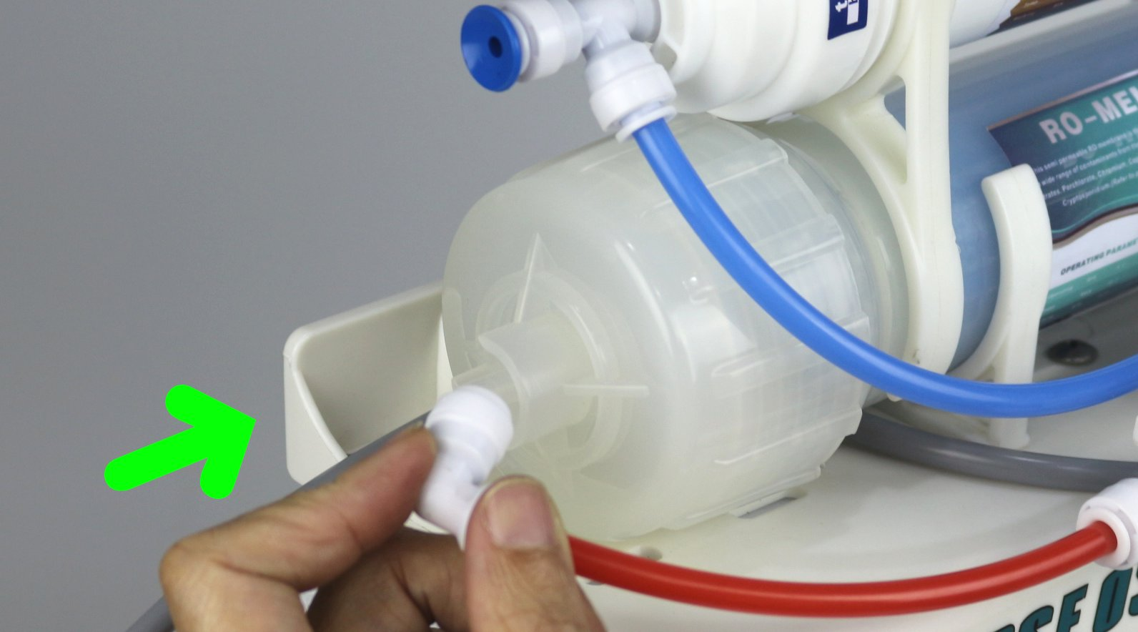
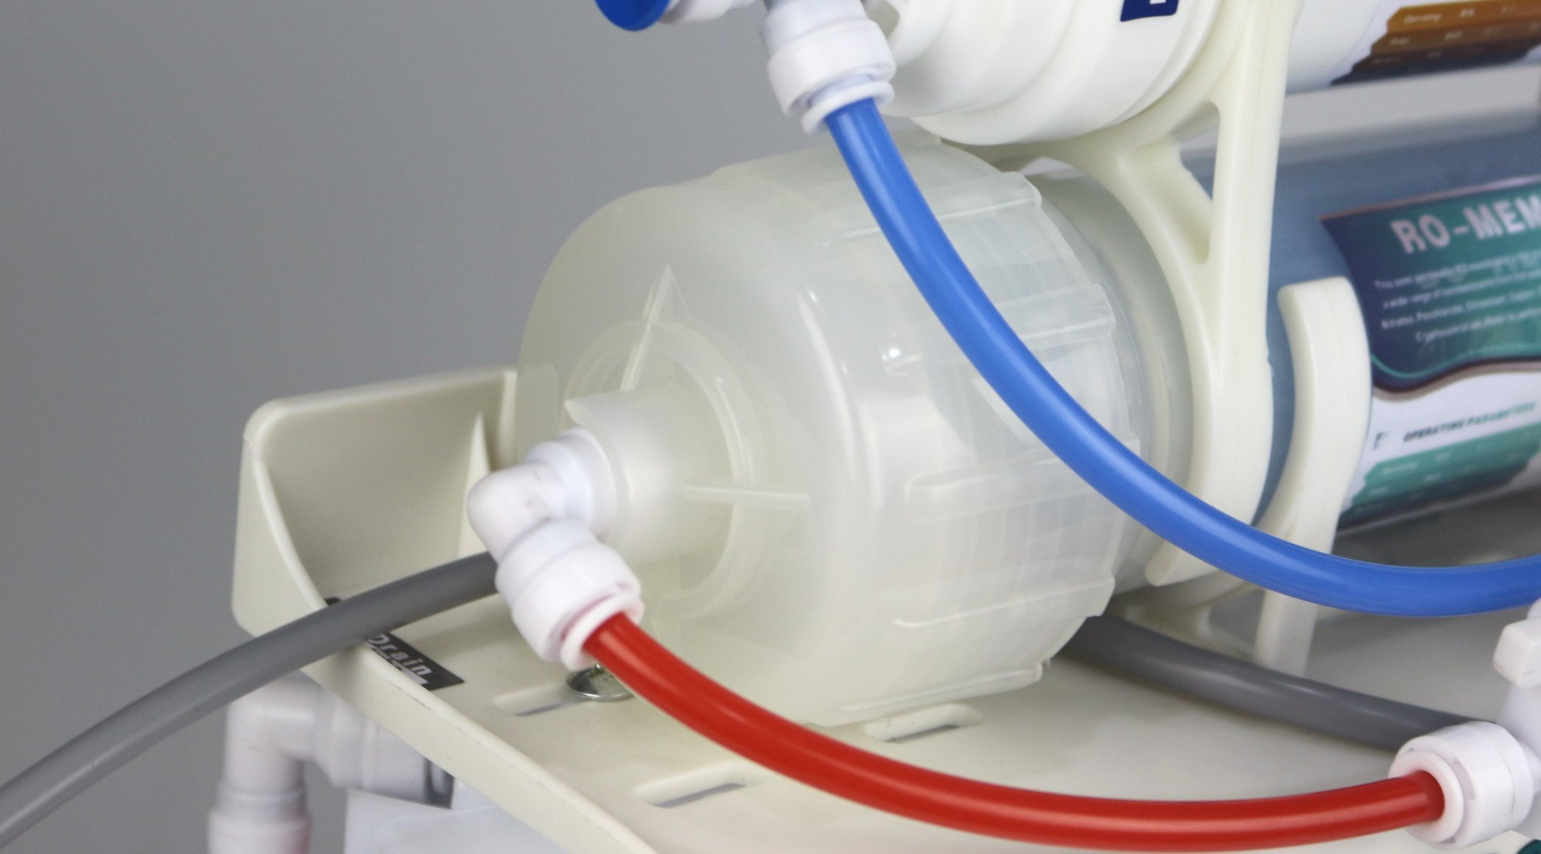
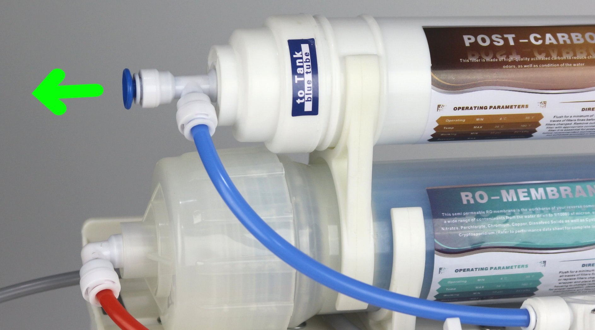
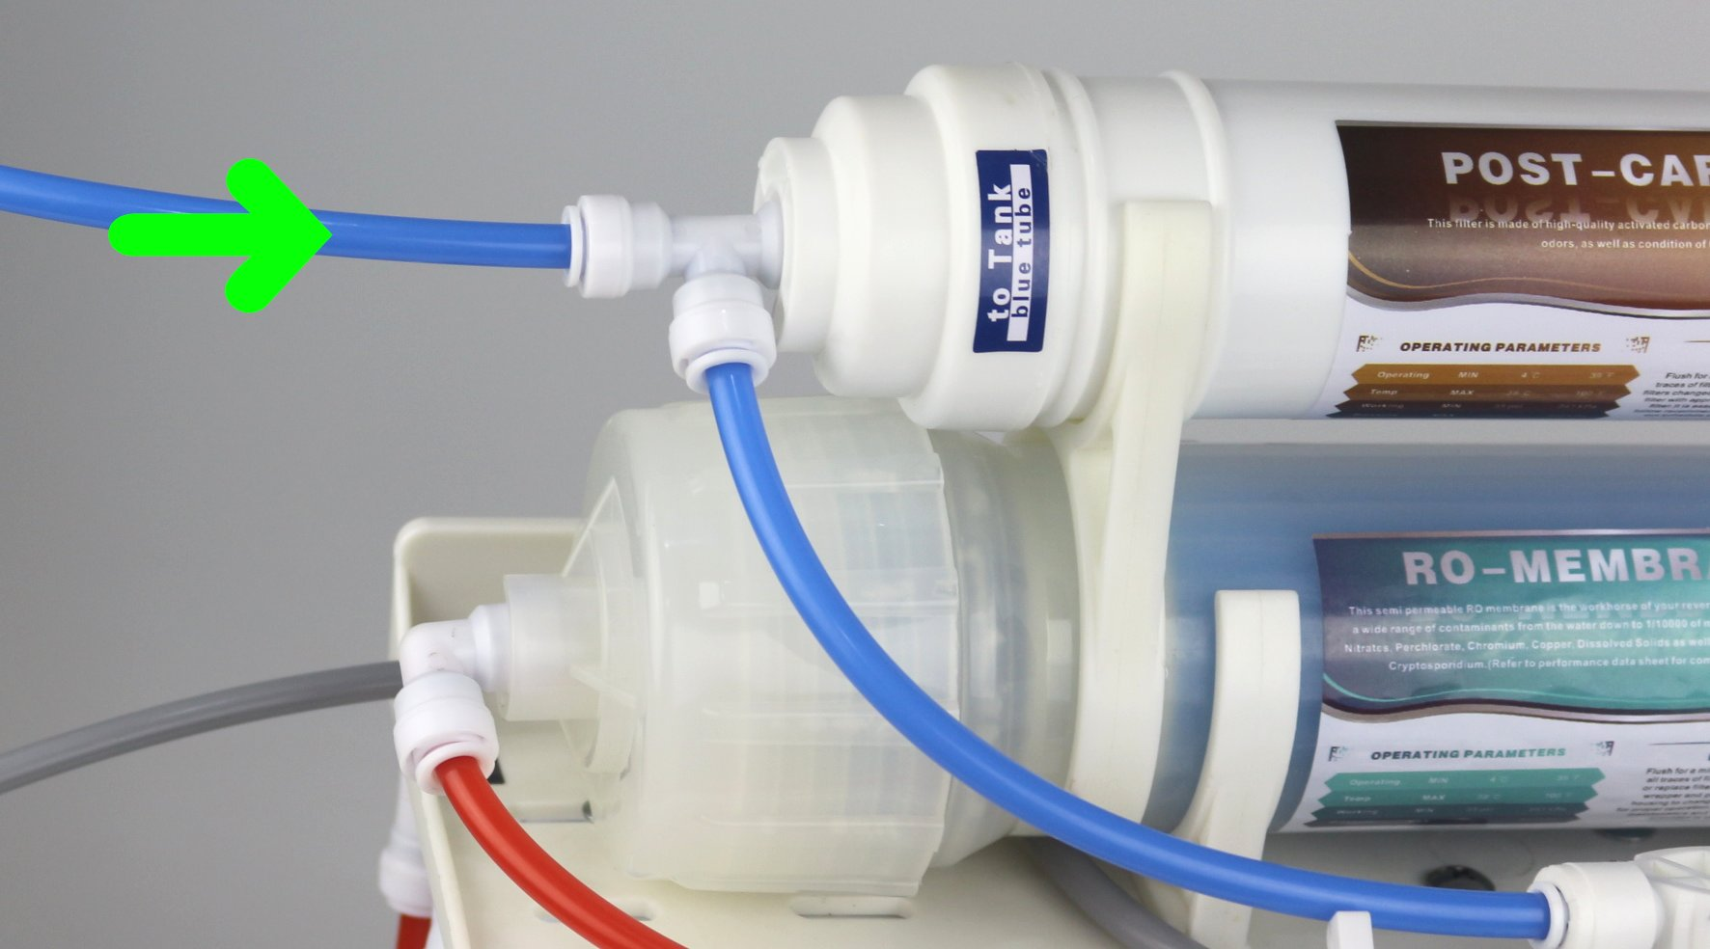
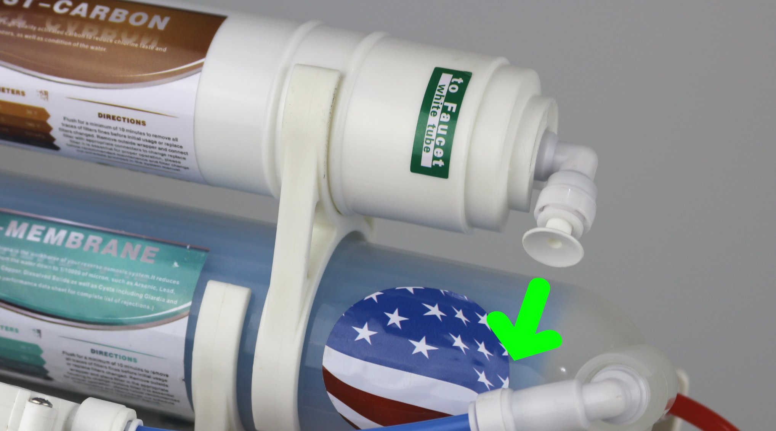
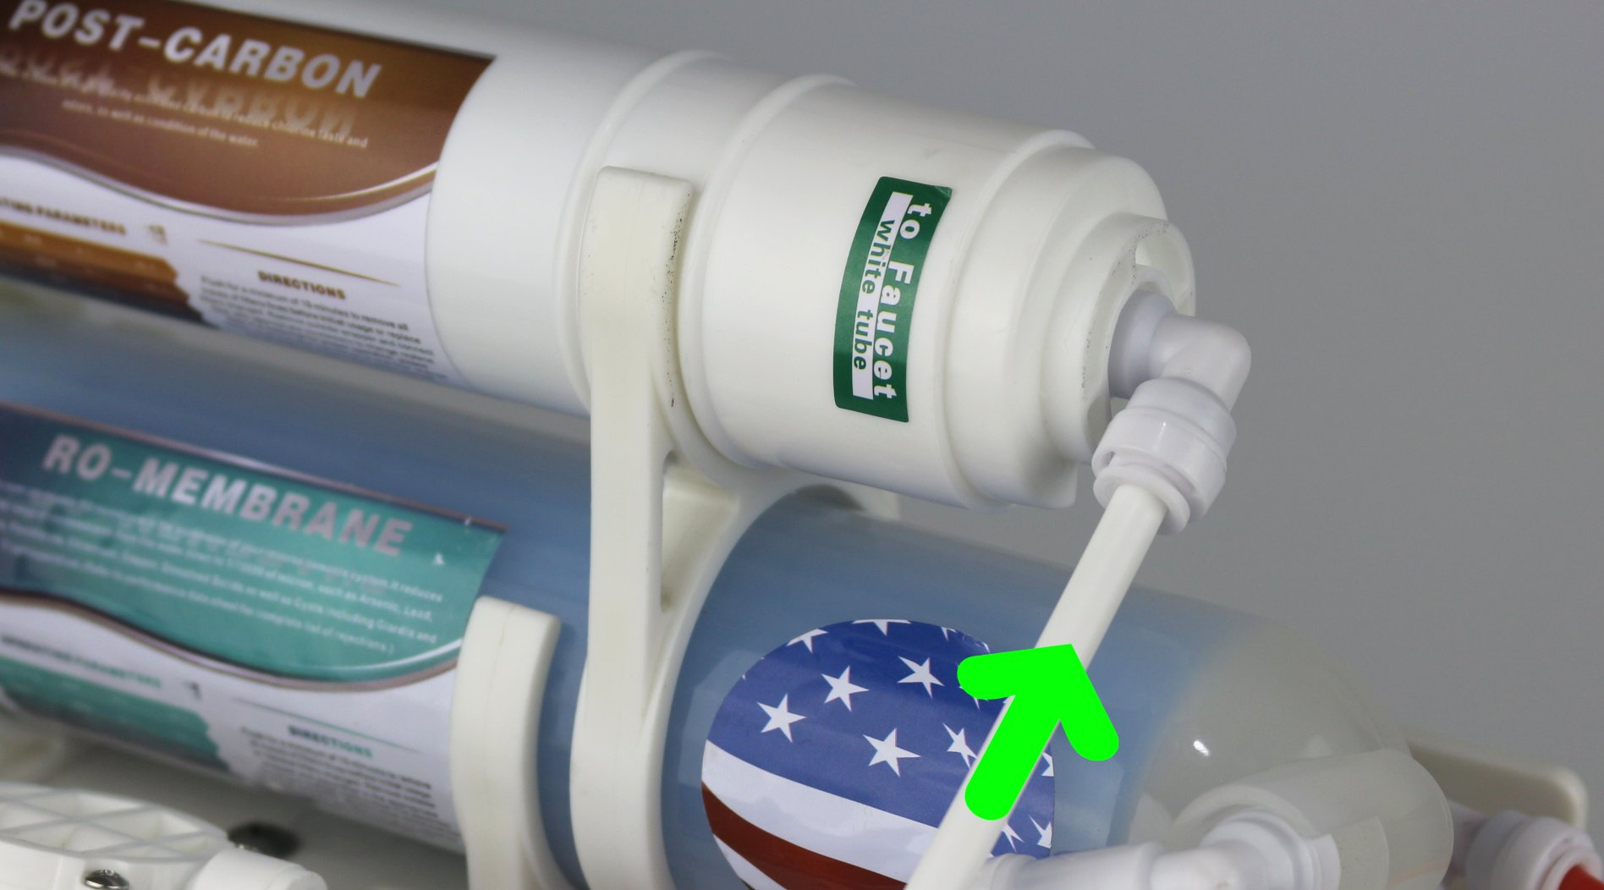
Find the left hand side 1/4” inlet on the cap of the RO membrane housing with the gray rubber stopper. Remove the gray rubber stopper from the cap.
Find the left hand side elbow fitting with the blue color tube and the Front-RO-In ball valve.
Fully insert the 1/4” end of the elbow fitting with the blue color tube and the Front-RO-In ball valve into the inlet on the cap of the RO membrane housing .
Find the left hand side tee fitting with the blue stopper and the blue tube on the inlet of the inline GAC filter. Find the 5 feet tank water tube (blue color ).
Remove the blue stopper from the tee fitting. Insert the 5 feet tank water tube (blue color ) into the 1/4” end of the tee fitting.
Find the right hand side elbow fitting with the white stopper on the outlet of the inline GAC filter and the 5 feet pure water faucet tube (white color ).
Remove the white stopper from the elbow fitting. Insert the 5 feet pure water faucet tube (white color ) into the 1/4” end of the elbow fitting.

Slide 6




INSTALLATION STEP 3
FEED WATER ADAPTER
CAUTION !
Must use COLD water line for the system. HOT water will severely damage the system.
1.) Find the cold water (angle) shut off valve underneath the sink and turn it off.
2.) On single-handle kitchen faucets, the hot water may have to be turned off to prevent any hot water cross over.
3.) Open the cold water faucet to release the pressure.
4.) If the water continues to come out of faucet with angled valve turned off, the house main water must be turned off.
5.) Remove the cold water supply hose of the faucet from the valve.
6.) Install the adapter and the incoming feed water tube (red color) as shown below, make sure the O-ring is inserted in the proper position.
1/2”
3/8”
ON Position
OFF Position

Slide 7



INSTALLATION STEP 4
WATER STORAGE TANK
NOTE :
Do not tamper with the air valve on low side of storage tank. It has been preset at 7-10 psi by the manufacturer.
1.) Fully insert the large end of the tank ball valve into the quick fitting on the center of the green cap of the water storage tank.
2.) Place the water storage tank in desire location. Since it is the pressure storage tank, it can stand up straight or lie down.
3.) Fully insert the water tank tube (blue color) from the tee fitting on the inlet of the inline GAC filter into the 1/4“ shorter branch end of the tank ball valve. The 1/4“ longer branch end comes with a white stopper, do not remove it.
4.) Turn on the tank ball valve to fill / discharge the water storage tank.
Tank Ball Valve
ON Position
OFF Position

Slide 8



INSTALLATION STEP 5
DRAIN LINE ADAPTER
There are three configurations to install the drain line adapter. It depends upon if there is the garbage disposal with/without dishwasher under the sink.
A: Garbage disposal with Dishwasher
1.) Shut off the power supply of the disposal or the circuit breaker before starting work.
2.) Remove dishwasher drain hose from disposal by unscrewing hose clamp, or expanding spring clamp with
pliers. Move clamp away from disposal nipple, then twist
hose back and forth while pulling away from disposal.
3.) Scrape the inside of exposed disposal nipple with a screwdriver to remove any buildup caused by dishwasher.
4.) Mount provided hose coupler one inch over disposal nipple. Then slip both provided new stainless steel hose clamps loosely over hose coupler.
5.) Slide the three-way adapter into remaining one inch of hose coupler until firmly seated against disposal nipple. Orient the ‘smaller branch" in a vertical position to connect RO drain tube. Tighten both hose clamps securely over hose coupler so that the three-way adapter is solidly mounted on disposal.
NOTE: Use tautness of dishwasher hose to keep tail of adapter slightly above horizontal. It is important for proper drainage and a clog free installation, if dishwasher hose material cannot be easily shortened or it is undesirable to do so, attach uncut end of hose to adapter, then tie up remaining slack with suitable material.
6.) Lift tail of adapter slightly higher than horizontal, and position semi-taut hose behind it. Take a measurement on the hose against the three-way adapter. Cut off excess hose squarely with a sharp Knife, then reuse original hose clamp and tighten securely.
7.) Insert the rubber plug with elbow quick fitting into the smaller branch of the three-way adapter. Then insert the RO drain tube (gray color) into the elbow quick fitting.

Slide 9





B: Garbage disposal without Dishwasher
1.) Shut off the power supply of the disposal or the circuit breaker before starting work.
2.) Knock out the plug inside the disposal nipple by using a hammer and flat screwdriver. Tap away all edges of the knock out plug until only a round hole remains. Remove all pieces of plug left inside disposal. Run fingers carefully to search for any hidden fragments.
3.) Mount provided hose coupler one inch over disposal nipple. Then slip both provided new stainless steel hose clamps loosely over hose coupler.
4.) Slide the bigger end of the two-way adapter into remaining one inch of hose coupler until firmly seated against disposal nipple. Tighten both hose clamps securely over hose coupler so that the two-way adapter is solidly mounted on disposal.
5.) Lift tail of adapter slightly higher than horizontal, and position semi-taut hose behind it. Take a measurement on the hose against the two-way adapter. Cut off excess hose squarely with a sharp Knife, then reuse original hose clamp and tighten securely.
6.) Insert the rubber plug with elbow quick fitting into the smaller end of the two-way adapter. Then insert the RO drain tube (gray color) into the elbow quick fitting.
C: Drill hole on drainpipe (no garbage disposal)
1.) The rubber drain plug is used to make a wastewater connection with the drainpipe under the sink. The rubber drain plug should always be installed before (above) the p-trap and on a vertical or horizontal drain. To avoid clogging the drain line with debris, do not install the drain saddle near a garbage disposal.
2.) Position the rubber drain plug at selected location and mark for the opening. Drill ½-inch (12.7mm) hole at mark through one side of pipe.
3.) Insert the rubber plug with elbow quick fitting into the hole of the drainpipe. Then insert the RO drain tube (gray color) into the elbow quick fitting.

Slide 10




INSTALLATION STEP 6
PURE WATER FAUCET
There is an Easy-Faucet-Install-Kit, if you do not want to drill a extra hole on the countertop or sink for the pure water faucet. It includes an extension ten feet tube and wall mounting bracket.
The pure water faucet may be installed on any flat surface. Most sinks have an extra hole for the mounting of additional faucets, sprayers or soap dispensers. If your sink does not already have an additional hole, you may use the Easy-Faucet-Install-Kit. Otherwise you have to drill a new 1" hole on the countertop.
Make sure the washer is big enough to cover the hole. If you want to drill a new hole on the countertop or sink, carefully mark the faucet location. Make sure it is far away enough from the regular water faucet so that they don't interfere with each other. Make sure that drilling the hole will not damage any pipe or wiring underneath the countertop or sink. Look to see if you can tighten the lock nut from below, before you drill a hole. assemble all parts together.
Assemble All Parts
On Position
OFF Position

Slide 11
Use the Easy-Faucet-Install-Kit
1.) Change the 3 feet white tube on the outlet of the inline GAC filter into the 10 feet white tube. Locate a desired place on the wall to mount the faucet bracket, then mount it.
2.) Assemble all parts of the pure water faucet with the faucet bracket. Connect the 10 feed white tube with the pure water faucet.
Dill a hole on the Stainless Steel Sink
1.) Determine the desired location for your pure water faucet on your sink surface.
2.) Place masking tape or duct tape on the determined location for the hole to be drilled.
3.) Use a variable speed drill set on slow speed and drill with a 1/8 inch (3mm) drill bit to make a center hole at the select location.
Note! Use water or lubricant to keep the drill bit cool while drilling.
4.) Enlarge the hole using a V4 inch (6.4mm) drill bit. Use factory approved method or approved plumbing practice to drill hole in sink.
5.) Enlarge the hole to 1/2-inch diameter. Keep bit well lubricated and drill slowly.
6.) On top of the sink, insert the chrome base plate (Escutcheon plate), and the large rubber washer in that order over the threaded mounting tube at the base of the faucet.
Dill a hole on the Porcelain Sink
To drill on a porcelain sink, a spring-loaded Relton style drill set is strongly recommended to prevent chipping. Avoid high speed drilling during the initial cutting of porcelain as this can cause chipping.

Slide 12




STARTUP STEP 1
FLUSHING 3 PRE-FILTERS (10 min.)
It is important for initial flushing three pre-filters to maintain the RO membrane performance more safe and efficient.
Front-RO-In
Back-Drain-Out
OFF Position
ON Position
1.) Turn off the Front-RO-In valve (red color tube) , and turn on the Back-Drain-Out valve (gray color tube) to make flushing water flowing from pre-filters to drainpipe directly, as shown above.
2.) Turn on both the cold water supply and the under sink feed water valve to start initial flushing pre-filters about 10 minutes.
3.) If any leaks are noted, turn off the valve. Check to see if all the tubes ,housing and fittings are secured properly, correct and tighten them.
4.) Turn off the feed water valve to stop initial flushing pre-filters.
5.) Turn on the Front-RO-In valve (red color tube) , and turn off the Back-Drain-Out valve (gray color tube) to make flushing water flowing from pre-filters to RO membrane housing, as shown below.
Front-RO-In
Back-Drain-Out
ON Position
OFF Position

Slide 13
STARTUP STEP 2
FLUSHING RO, TANK, POST-FILTER (6 hr.)
DO NOT drink the water produced in the initial flushing of the system.
1.) Turn off the tank ball valve and open the pure water faucet for continuous flow (flow rate may vary). After few minutes, the water will start to drip out of the pure water faucet.
2.) If any leaks are noted, turn off the valve. Check to see if all the tubes ,housing and fittings are secured properly, correct and tighten them.
Filling The Water Storage Tank
3.) Then turn on the tank ball valve and close the pure water faucet to start flushing the RO membrane and filling the tank for two hours.
Discharging The Water Storage Tank
4.) After two hours, open the pure water faucet to start flushing the water storage tank and post-filter until the water flow changing to dripping (the tank is completely discharged).
5.) REPEAT Filling (Step 3) and Discharging (Step 4) the water storage tank TWO MORE TIMES.
6.) Close the pure water faucet to finish the initial flushing and start filling the fourth last tank, then you may drink the pure water.
7.) Check for leaks daily during the first week of use and periodically thereafter. If you cannot stop the leaking, please contact us.
8.) You may notice that the water may be milky colored during the first week. This is an indication of air bubbles in the water and it is normal and safe to drink.

Slide 14
TROUBLESHOOTING & FAQ
Q: Why does the system produce small amount of water or no water from pure water faucet?
A: There are some different situation:
If the RO system just start up, normally it may takes 2-3 hours to fill the tank.
Please check if the air pressure in the storage tank is too low. If so, please add pressure to storage tank. The pressure should be 8-10 psi when the tank is empty.
Please check if the sanitizer of the tank is flushed out. If not, please drain tank and refill it overnight.
Please check if there is any crimps in tubing. If so, please make sure all the tubing are straight.
Please check if any pre-filter is clogged. If so, please replace the pre-filter.
Please check if the RO membrane is fouled. If so, please replace the RO membrane.
Q: Why does my pure water taste or smell offensive?
A: There are some different situation:
Please check if the post-filter is depleted. If so, please replace the post-filter.
Please check if the RO membrane is fouled. If so, please replace the RO membrane.
Please check if there is any crimps in tubing. If so, please make sure all the tubing are straight.
Q: Why does the system produce less pure water than it produces waste water?
A: This is normal; the ratio for the pure and waste water should be 1:3.
Q: Why does the system produce milky colored water and/or air bubble in the pure water?
A: This is normal; air in the system is a normal occurrence with initial startup of the RO system. This milky look will disappear during normal use within 1 to 2 weeks.
Q: Why does the system produce no waste water?
A: Please check if the flow restrictor is clogged. If so, please replace the flow restrictor.
Q: My RO system is making noise from its auto shut-off valve.
A: Please check your water pressure; if you use a booster pump, set it to 60-65 PSI.
Q: My RO system is making noise from its restriction in drain line.
A: It may be blocked sometimes caused by debris from garbage disposal or dishwasher.
Q: I have a leaking problem.
A: First at all, check the leaking from the thread (the screw on the housing end) or the tube plug-in end.
If leaking is from the thread, please detach the fitting and wrap more Teflon tape on it, then re-screw it back into the housing.
If leaking is from tube-plug-in side, cut off a small piece of tube from the end, because it could be slanted, twisted, or deformed. Please disconnect the tube and re-push the tube all the way into the socket. If the tube is not long enough, replacing a new tube can usually solve the leaking problem.
If you have pre-filter housing leaking problem, please try twisting open the leaking stage housing. Take out the O-ring and check if the ring is still in good shape. Or try to find if there is any manufactory defects on the groove of the housing, that would cause it to seal improperly. If everything looks good, add some Vaseline on the O-ring and groove, then re-screw on the housing. This will usually resolve the leaking problem.
If you still cannot stop the leaking, please contact us.

Slide 15
INFORMATION & WARRANTY
INFORMATION
Read the installation manual before installing this system.
Install the system at a location with adequate drainage.
Prepare plumbing tools such as wrenches, screwdriver, Teflon tape, protecting eye-glasses, etc.
Only connect the RO with COLD water and a clean water source, NO seawater.
Recommended water source TDS reading is not to exceed 1000 PPM.
System operation minimum temperature: 39ºF, maximum temperature: 100ºF.
35 PSI minimum is requited for the RO to operate, at 65 PSI 25°C is best.
If the pressure of the incoming tap water is too low (less than 35 PSI), a booster pump is required.
The installer is responsible for any leaks resulting from installation of tube or related fittings.
You must check over the entire unit completely while under proper water pressure to ensure that the unit is not leaking and is functioning properly.
Please flush the whole RO system for at least about 10-15 gallons, or drain out the water tank at least 3 times for first-time usage.
All RO systems will create waste water. Most RO systems are designed for 1:(3.5 - 4.5) as standard.
This system is designed for the ratio from pure to waste water is about 1:3.
WARRANTY
This water system unit is for INDOOR use ONLY.
To avoid using extremely HOT/COLD water, and protect against sudden temperature changes.
Install the system under supervision of a professional, licensed installer or plumber.
Inspect all connections after the installation to make sure NO LEAKS occur.
Wait and inspect the system AFTER the water is pressurized.
MUST install the pressure regulator at the high water pressure area (over 85PSI).
Strongly recommended: SHUT OFF the water supply when homeowner/user will not be using the water system for a long period of time.
IMPORTANT
Please contact your insurance carrier before installing the water system.
The manufacturer WILL NOT cover ANY water damage under any circumstance.
These are our recommendations to avoid any water damage.
Must install the PRESSURE REGULATOR/PRESSURE LIMITING VALVE to avoid water damage.
Homeowner/User is obligated to properly maintain the water system unit periodically, which includes the following:
Replace the O-ring seals on the filter canister, fitting and filter cartridges.
Replace the fitting connectors with proper replacement parts.
Replace the filter canisters with proper replacement parts.
Replace the filter cartridges with the correct size and length replacements.
Replace the water seal tape on ALL connector fittings.
ALL O-RING SEALS, FITTINGS, FILTER CANISTERS, AND WATER SEAL TAPE WEAR OUT AFTER CERTAIN PERIOD OF TIME. THE LIFETIME OF THESE COMPONENTS ARE SUBJECT TO WATER QUALITY. THEREFORE, ADEQUATE MAINTENANCE IS NECESSARY AND MANDATORY
Please contact a professional, licensed installer or plumber who meets the above requirements. The manufacturer's insurance carrier WILL NOT cover any loss. Please consult your own insurance carrier for terms and conditions.
WARNING
Do not install the system where the water is microbiologically unsafe or of unknown quality adequate disinfection before or after the system.

